Slide 1
Investing in Healthy Futures
Karen Bailey, Youth Earn & Learn
Leahmarie Gottlieb, St. Paul’s Community Development Corporation

Slide 2
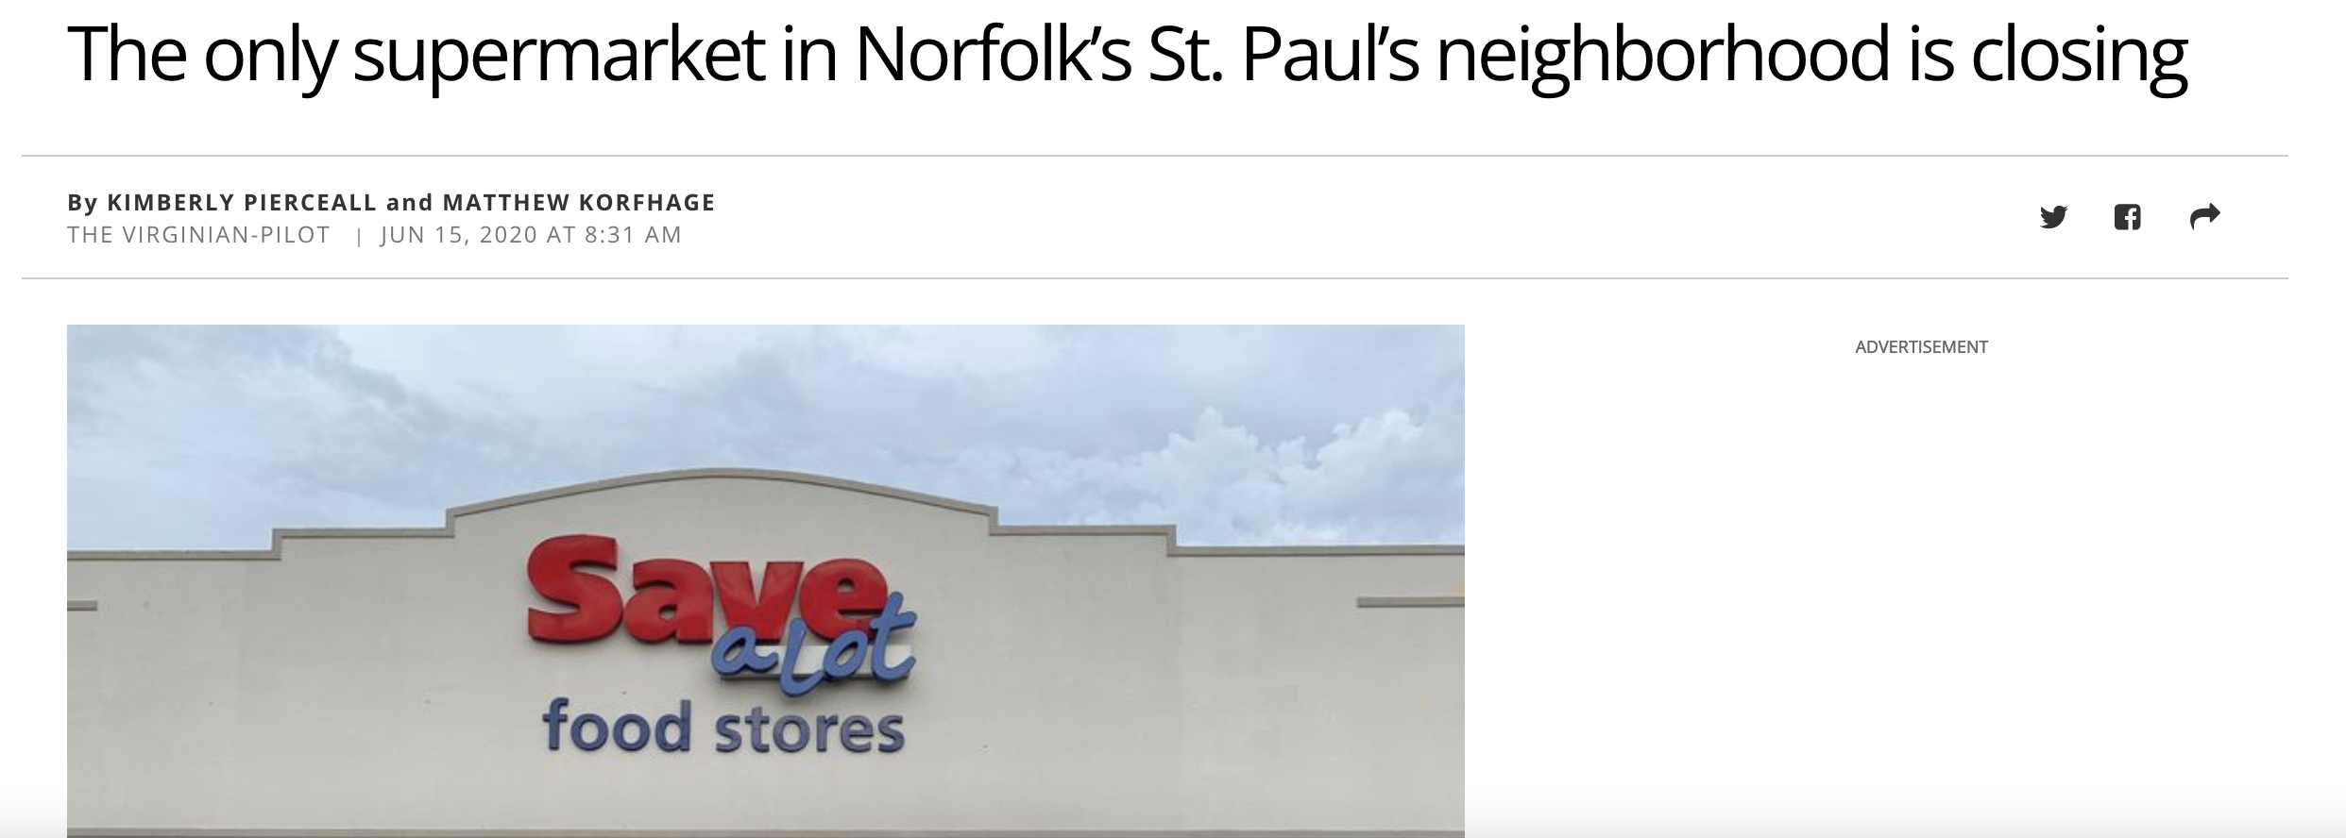

Slide 3
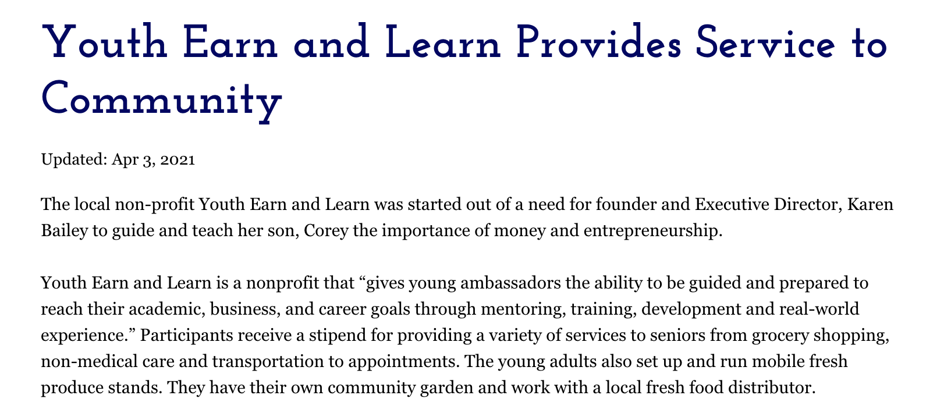

Slide 4
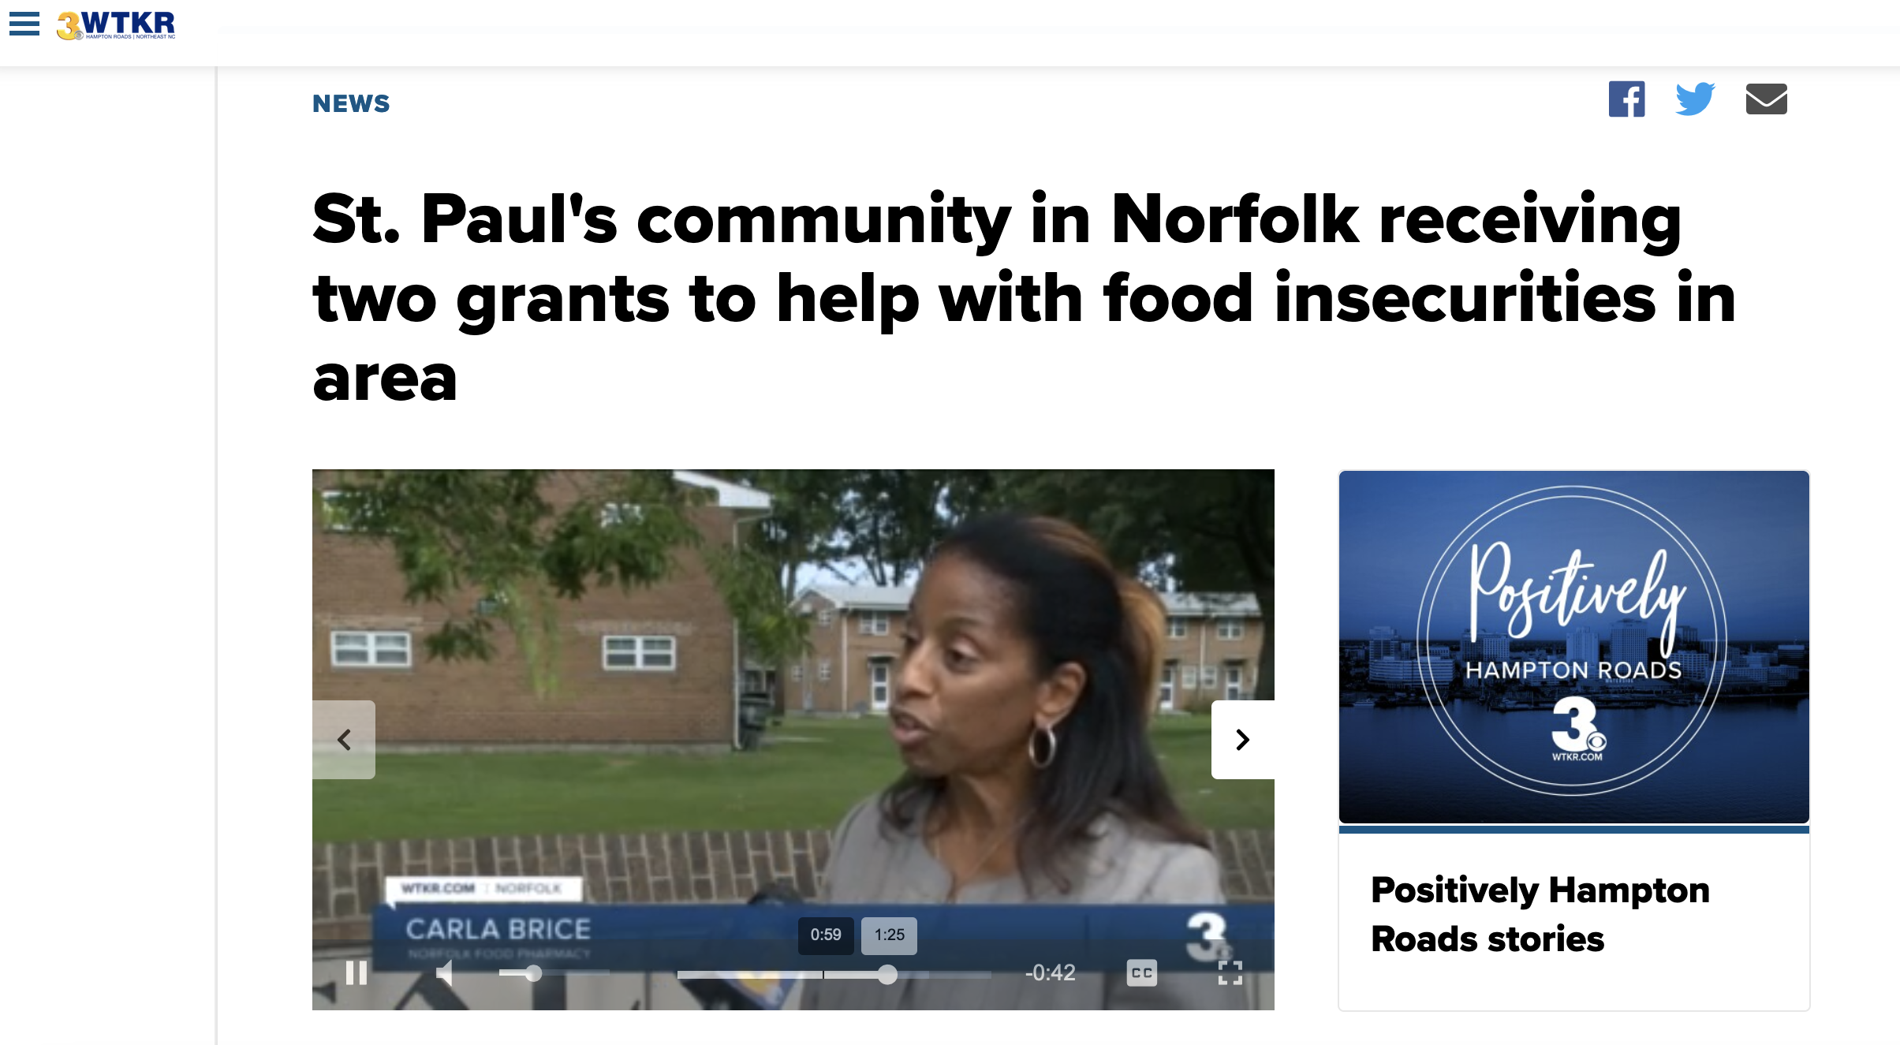

Slide 5
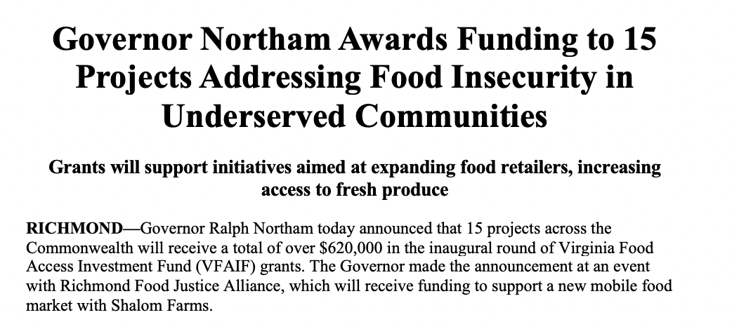

Slide 6
“Hungry people cannot work; hungry
children cannot learn. Food security
depends upon three factors: availability,
stability and accessibility of food supplies.
To achieve food security, a community
must be able to grow sufficient food; and similarly, households must have sufficient income to purchase the food they are unable to grow for themselves.”

Slide 7
“Hungry people cannot work; hungry
children cannot learn. Food security
depends upon three factors: availability,
stability and accessibility of food supplies.
To achieve food security, a community
must be able to grow sufficient food; and
similarly, households must have sufficient
income to purchase the food they are
unable to grow for themselves.”
“Imagine having to go to the nearest convenience store to buy milk, or taking a bus with bags of groceries and walking several blocks home, while also relying on canned fruits and vegetables due to the lack of access to affordable, healthy food or fresh fruits and vegetables.”

Slide 8


Slide 10
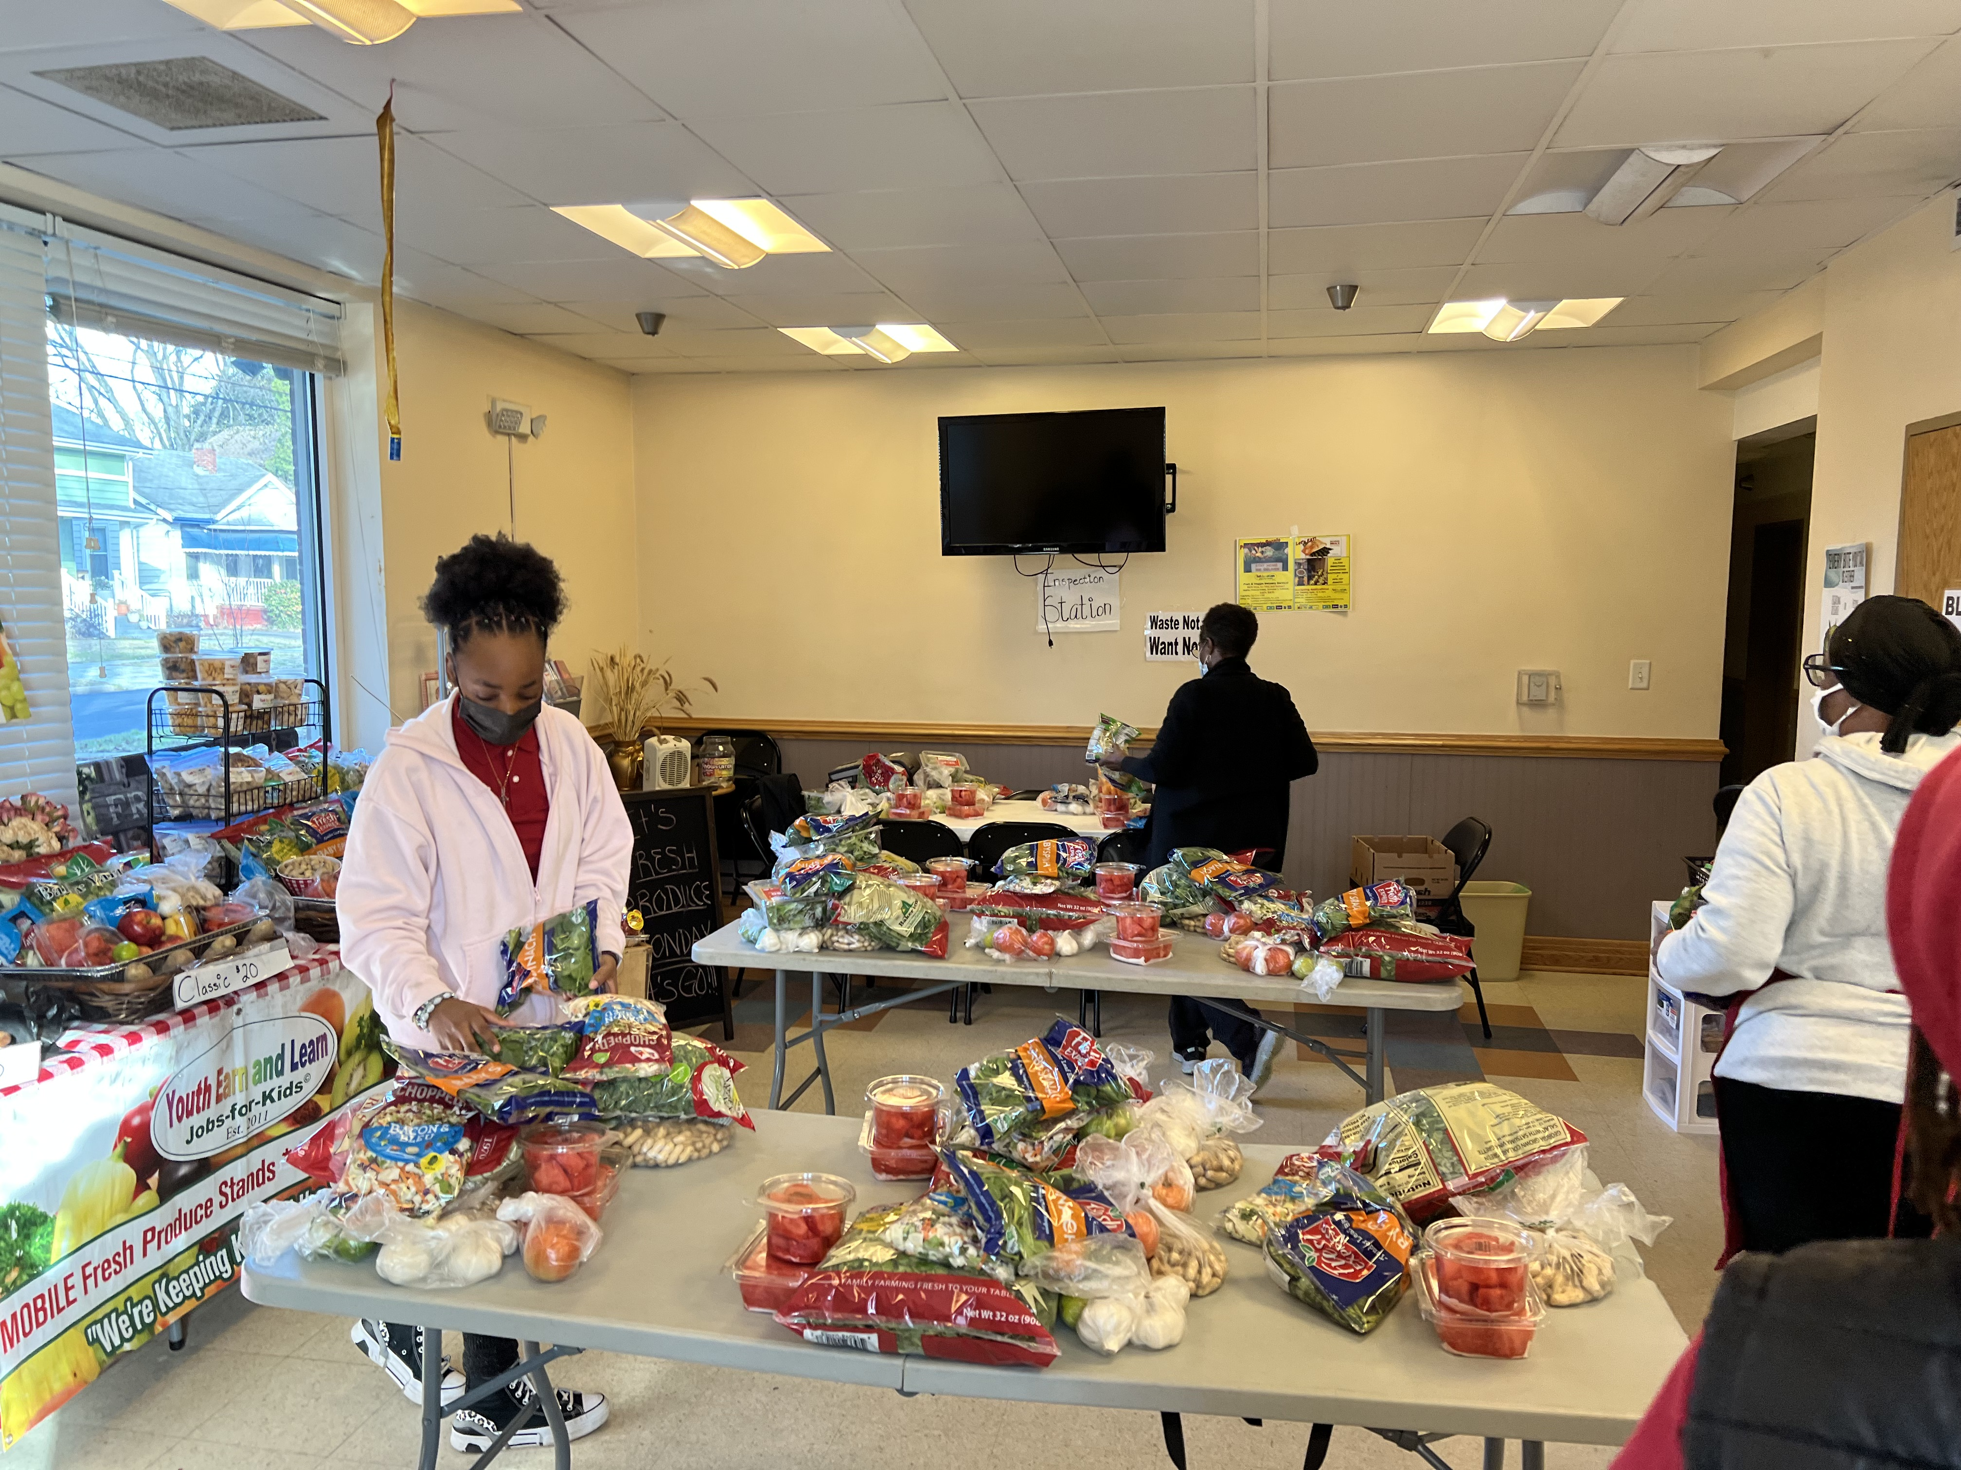
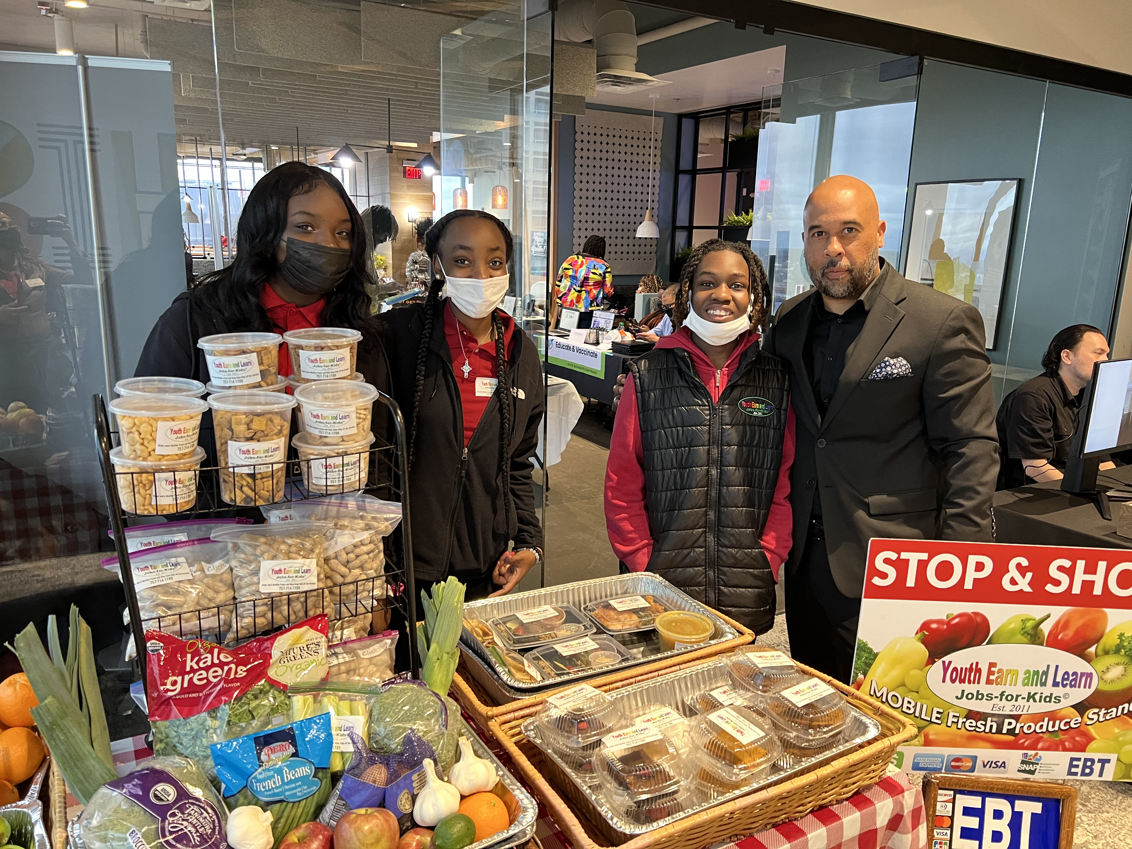
#FoodDesertSolutions
Training & Development
Youth Earn and Learn Jobs-for-Kids©
5th Annual Youth Empowerment Summit: How to Earn Six Figures with or without a College Degree! ©
Adult Learn and Earn Jobs-for-U (Unemployed/Underemployed) ©

Slide 11
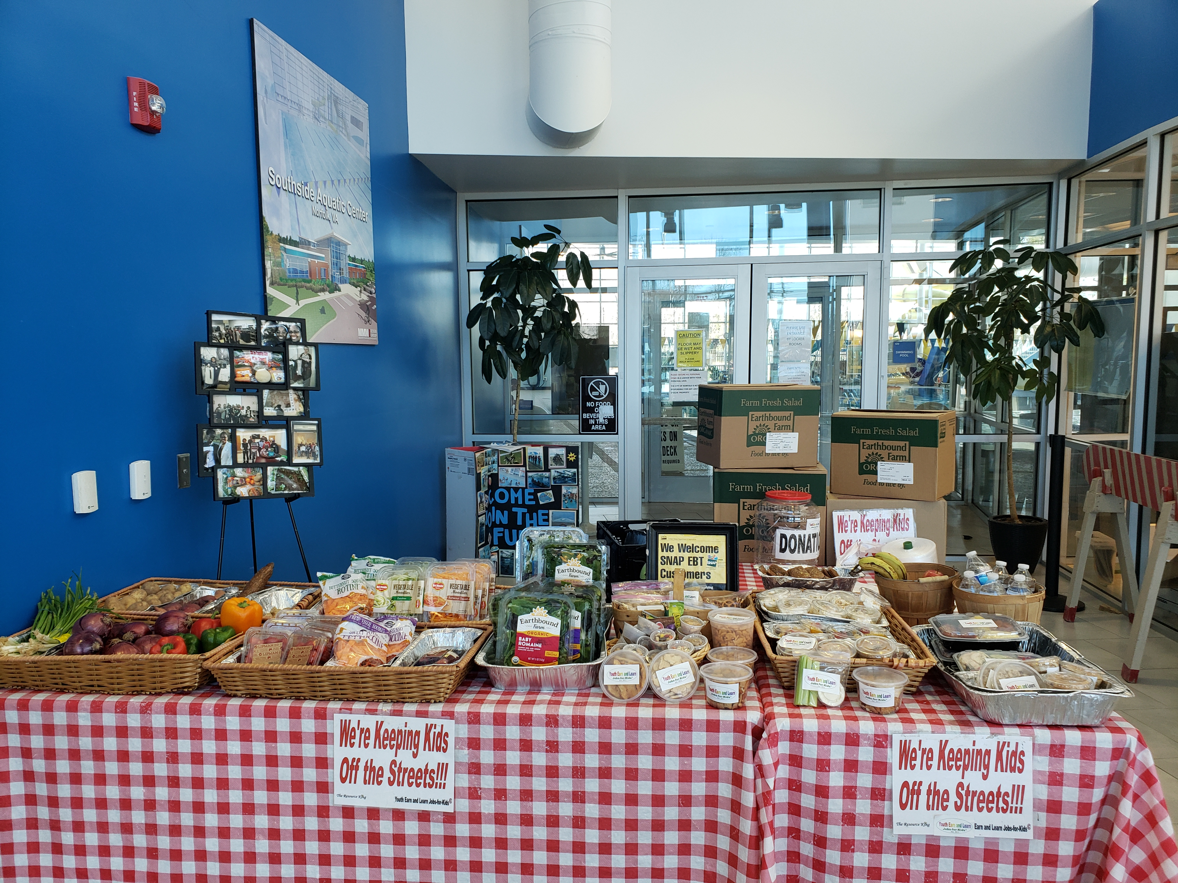
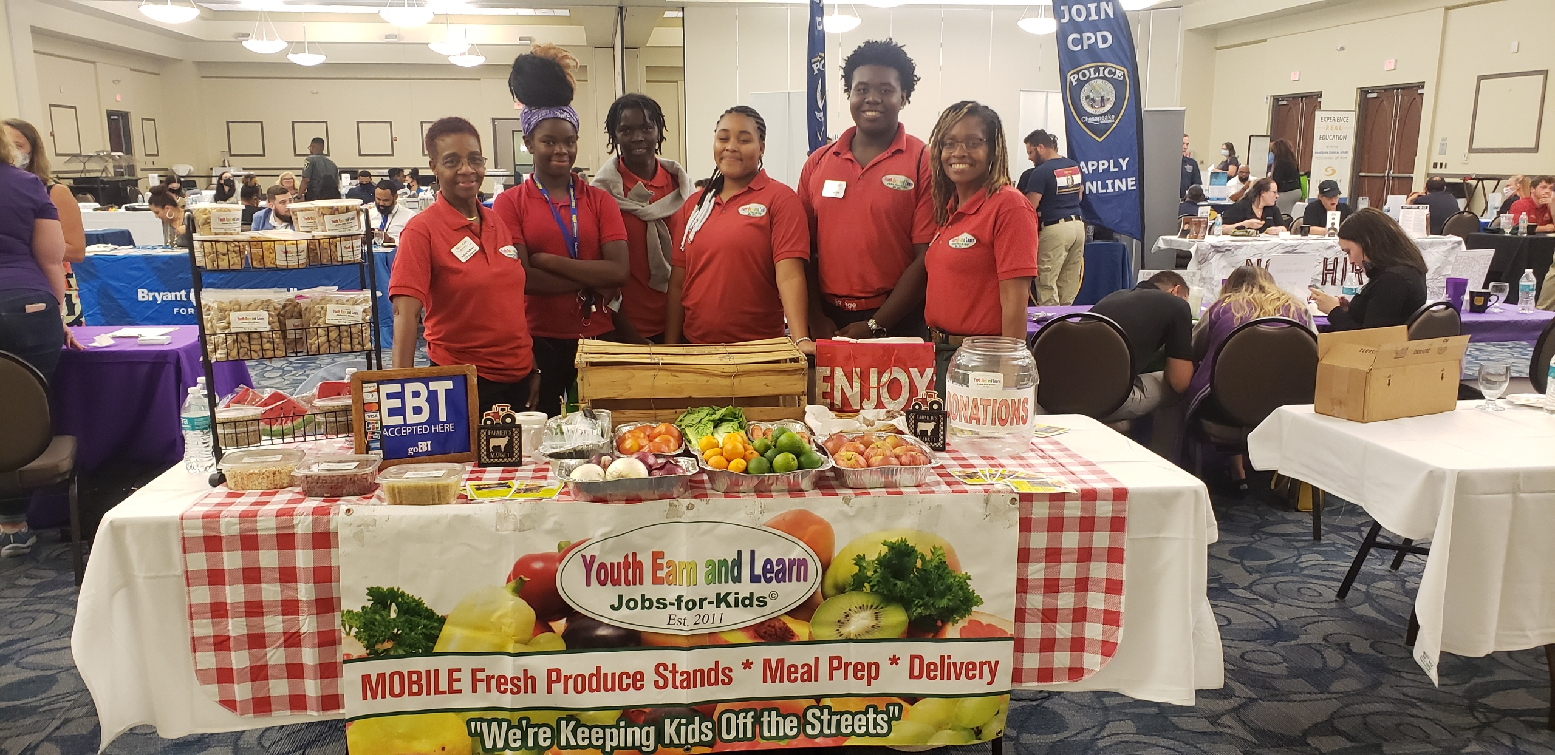
Products & Services
Fresh Produce Grab Bags and Mobile Fresh Produce Stands
Community Gardens
Healthy Home-Delivered Meals
Call-In Grocery Shopping & Delivery Service
Nutritional Education and Culturally Relevant Cooking Classes
Red Apron Talks

Slide 12
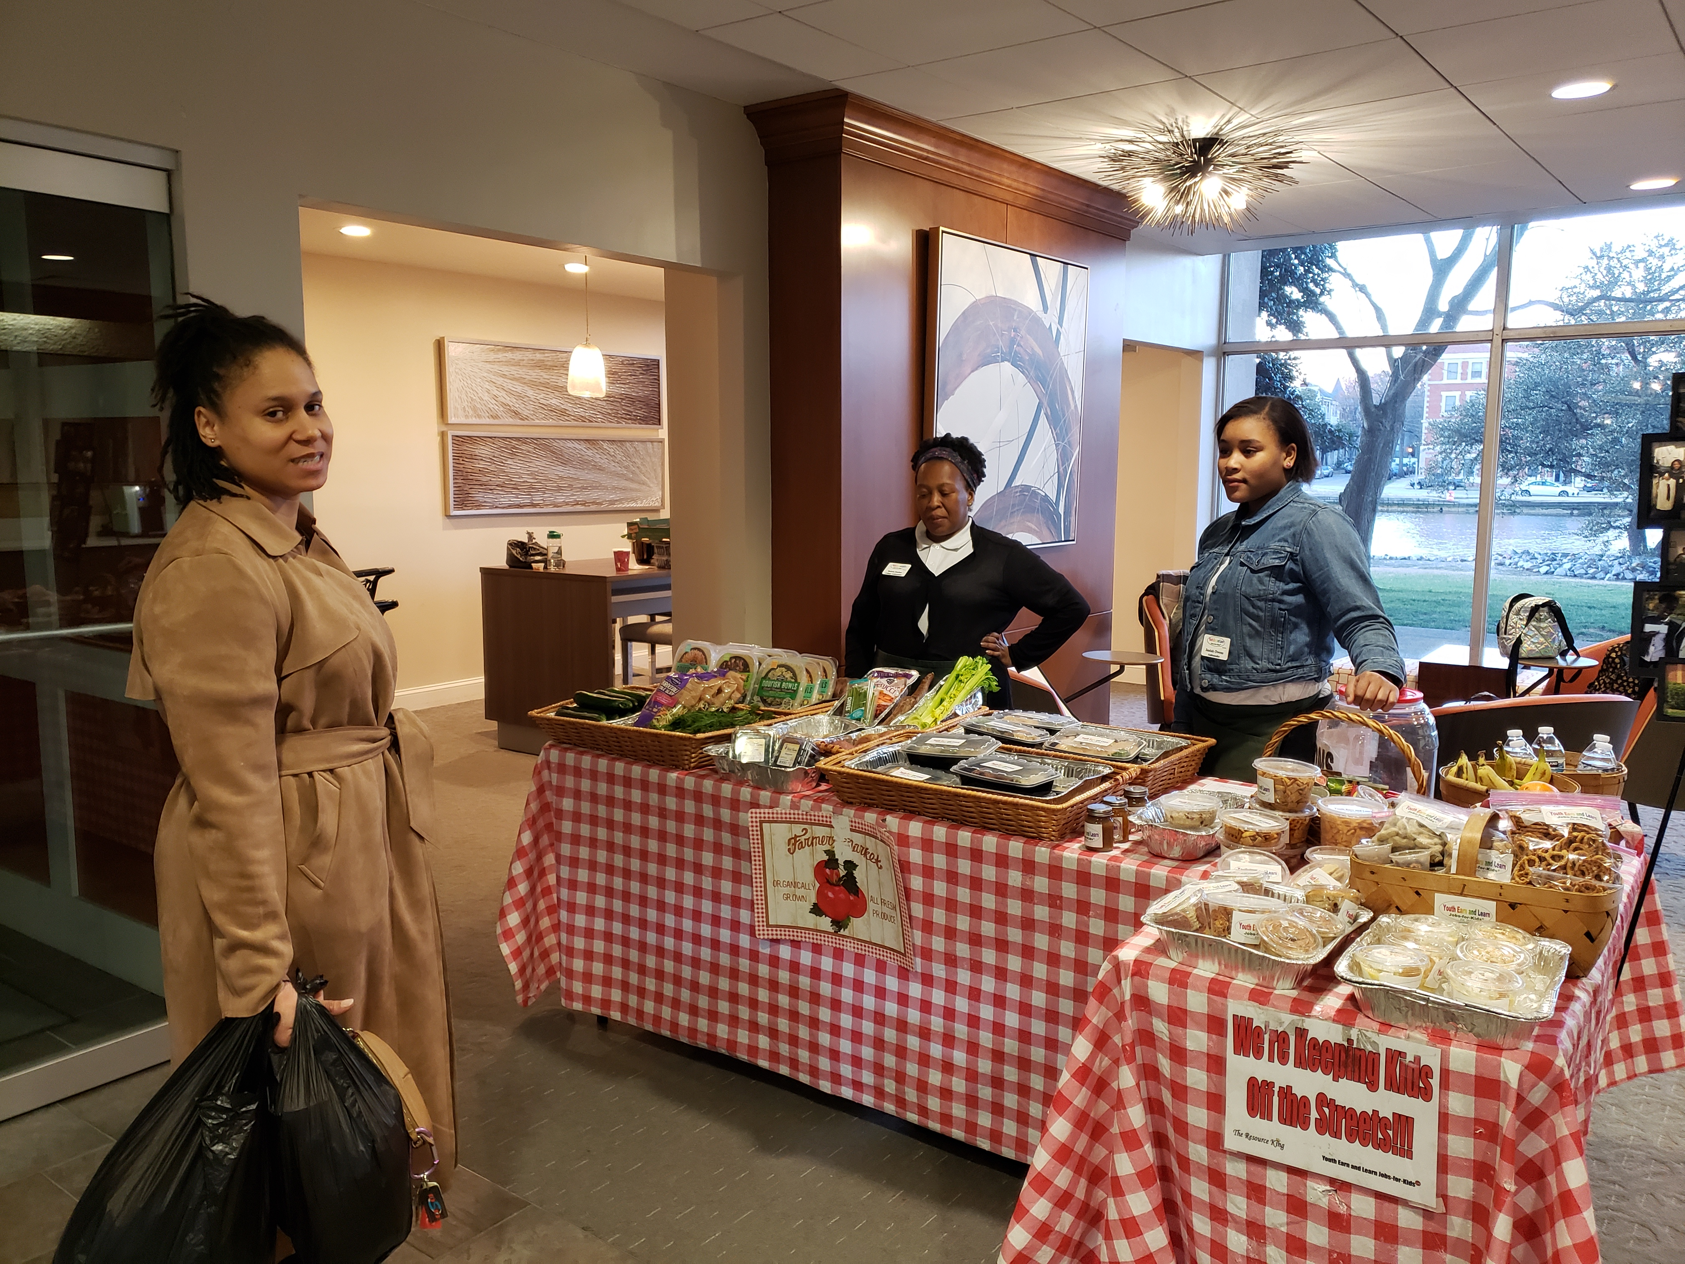
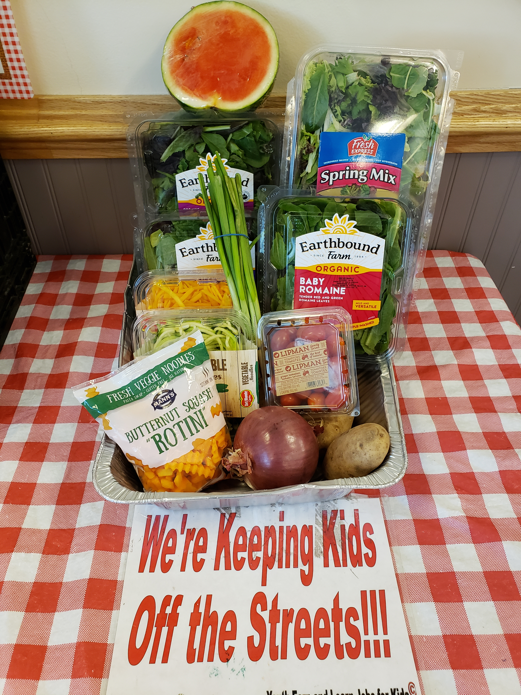
On-the-Job Training with Real World Work Experience

Slide 13


Slide 14
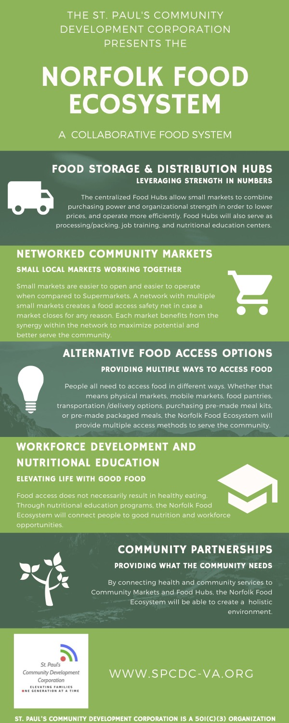


Slide 15





…brings a "food is medicine" approach to address a key social determinant of health (food apartheid) for patients with chronic illnesses related to or negatively impacted by poor diet.

Slide 17
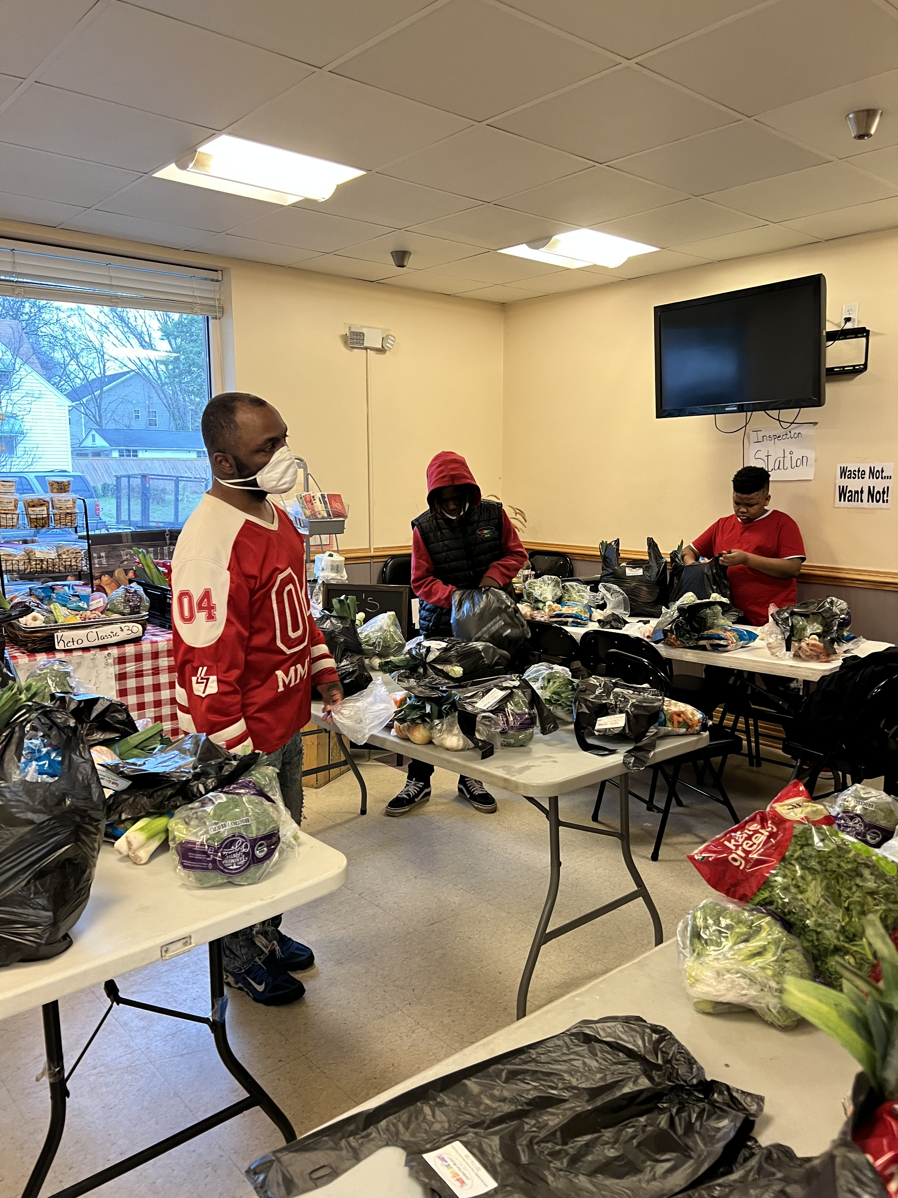

Slide 18
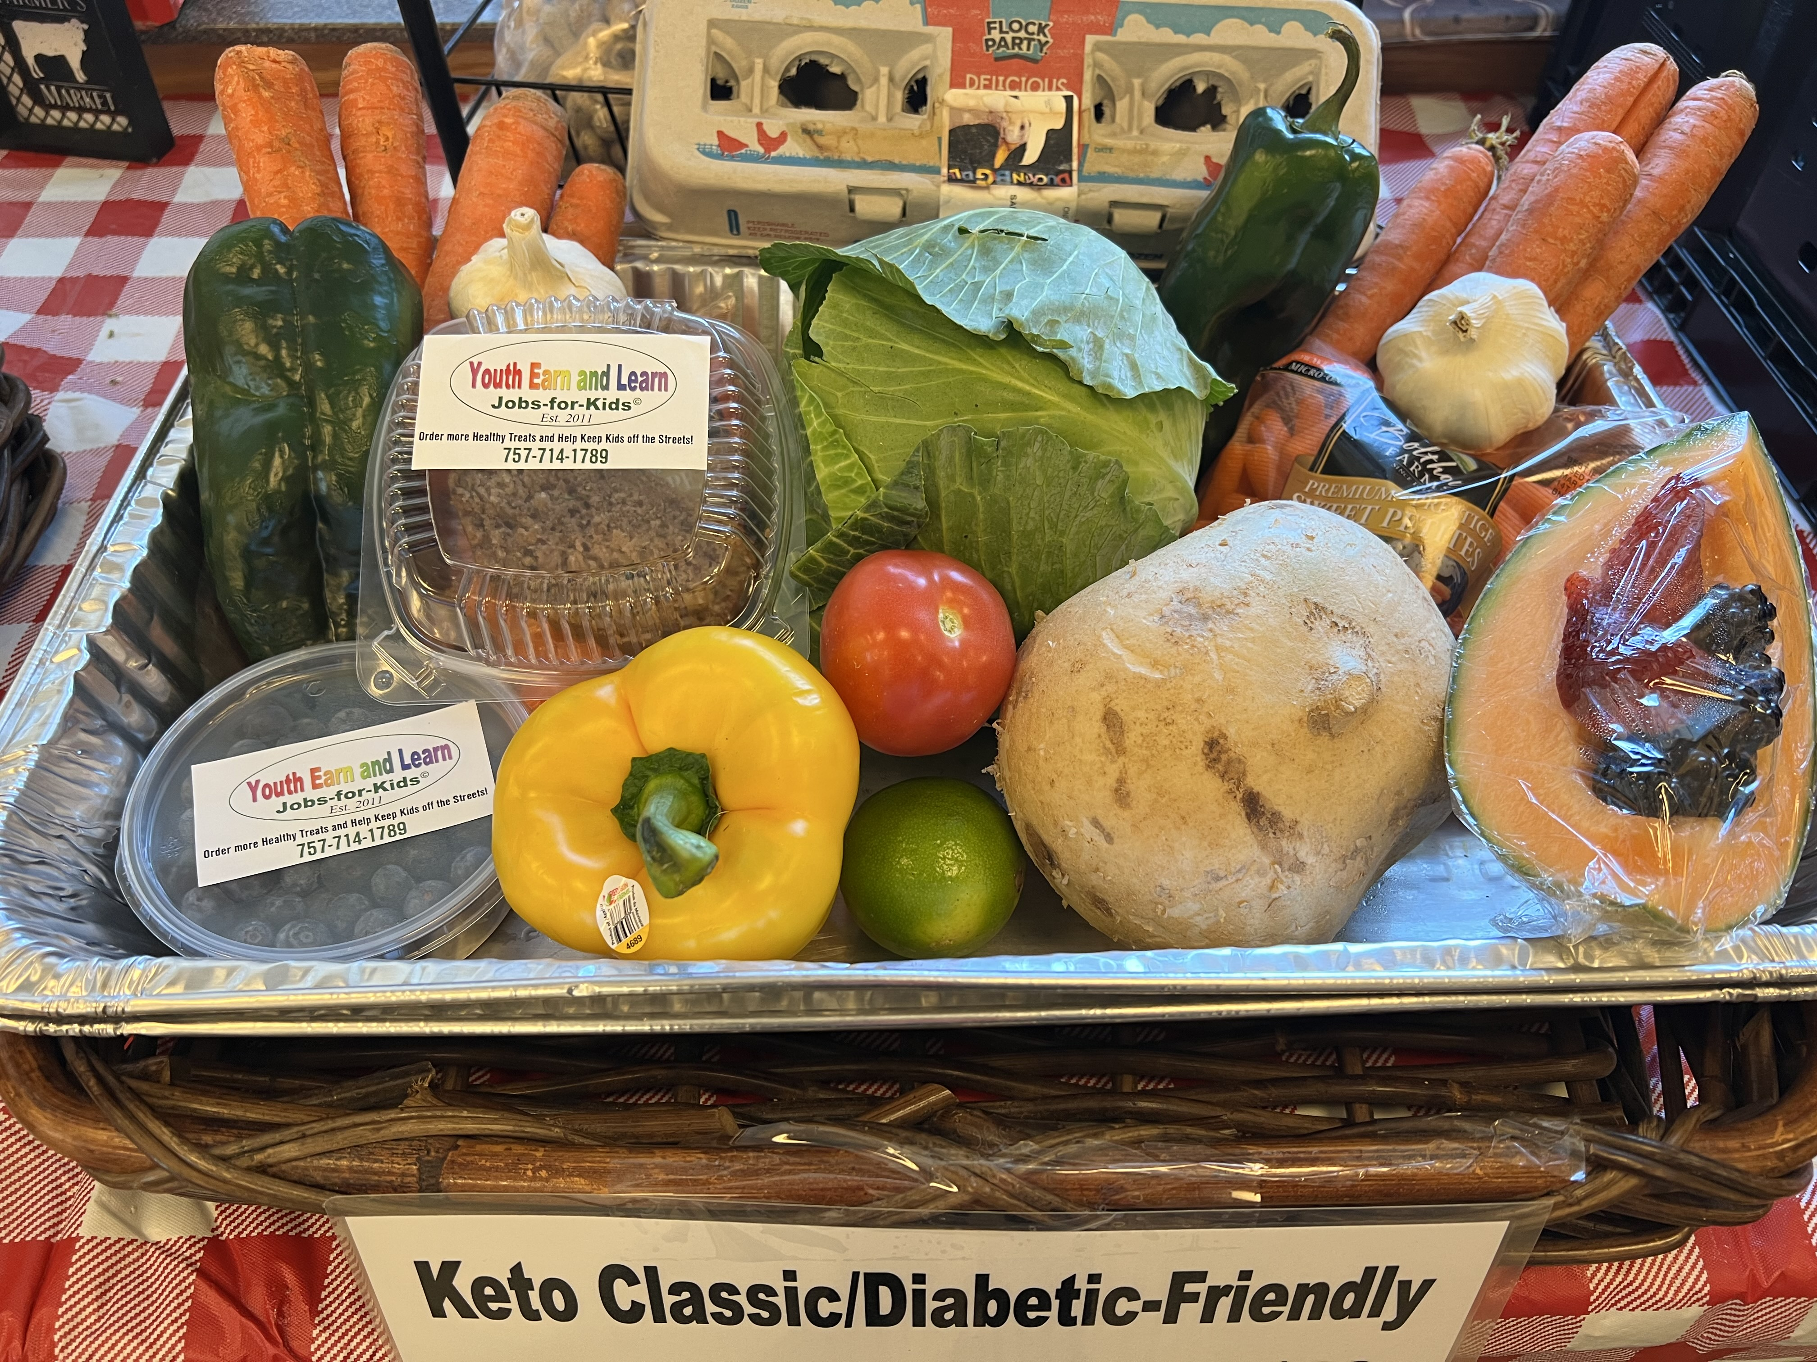

Slide 19
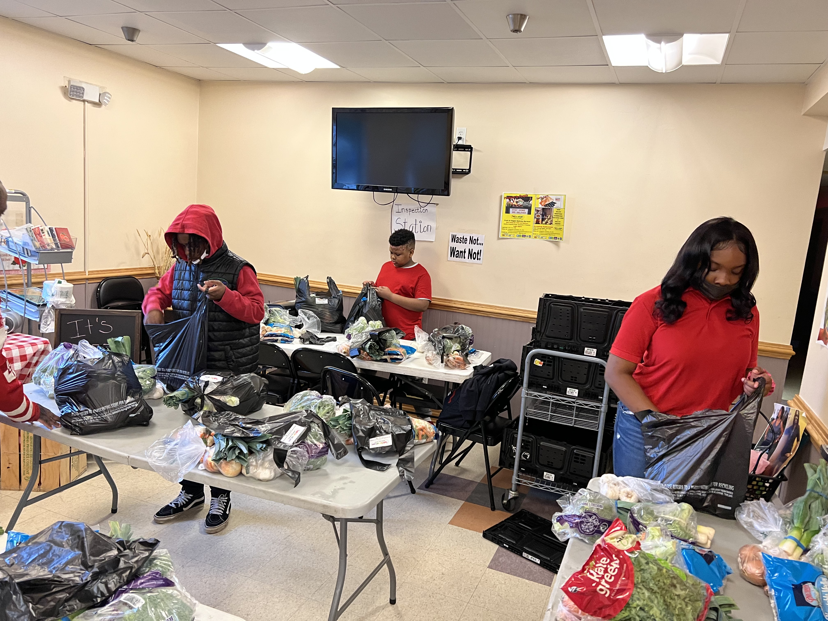
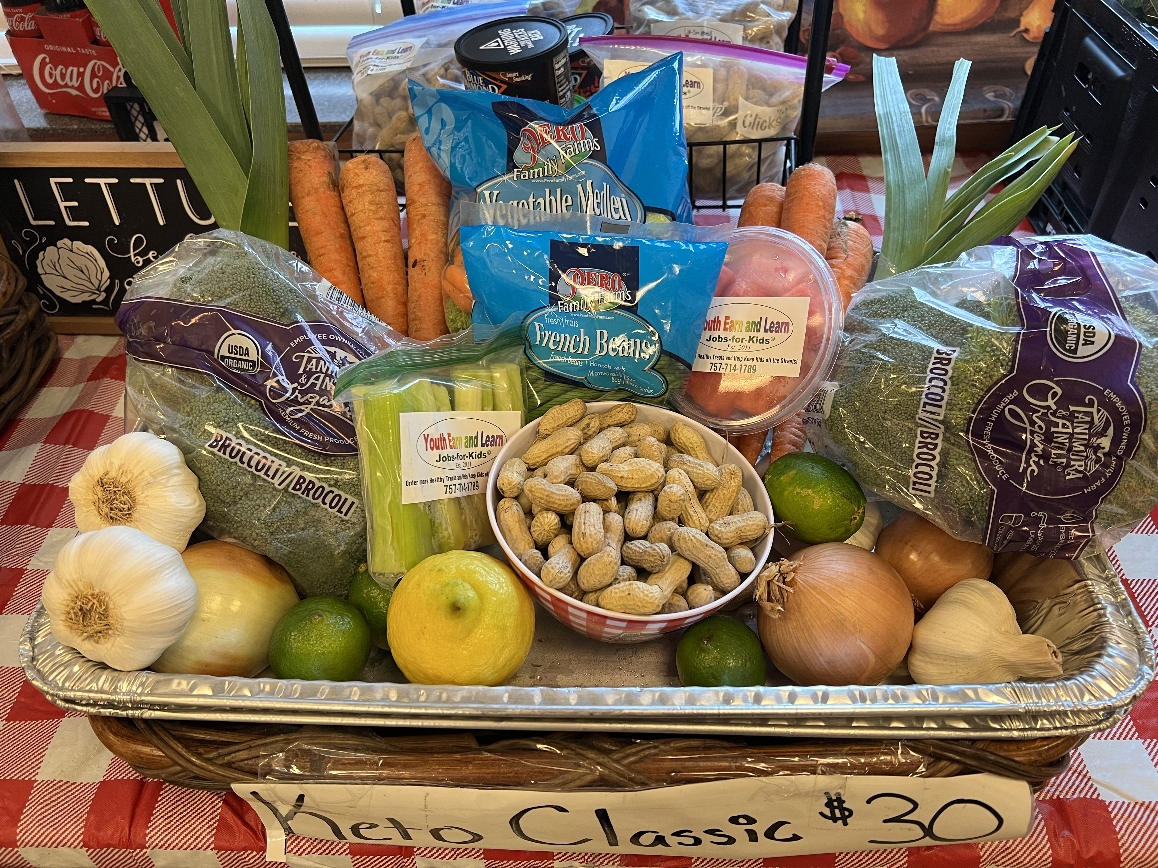

Slide 20
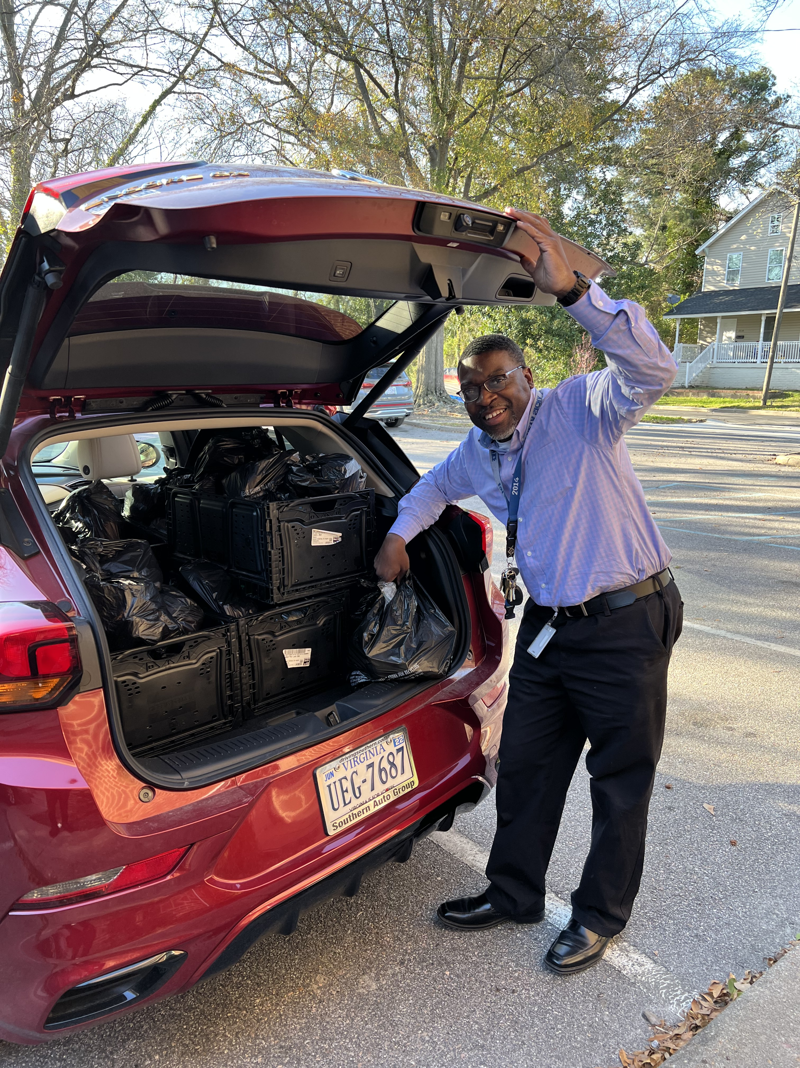

Slide 21
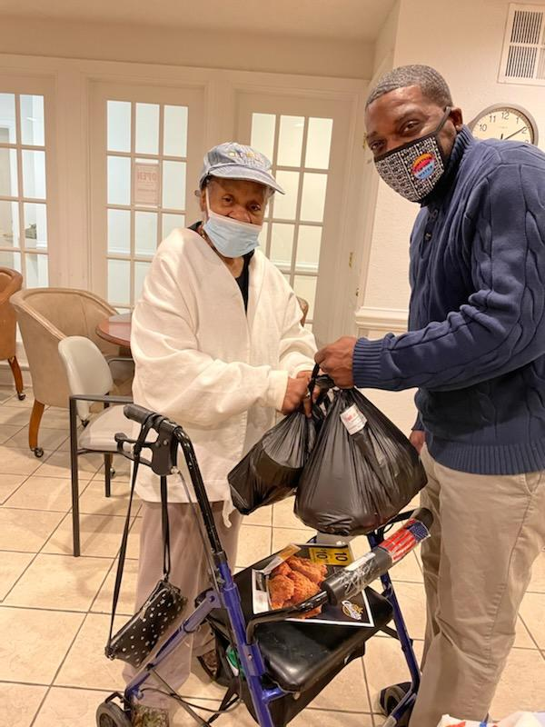
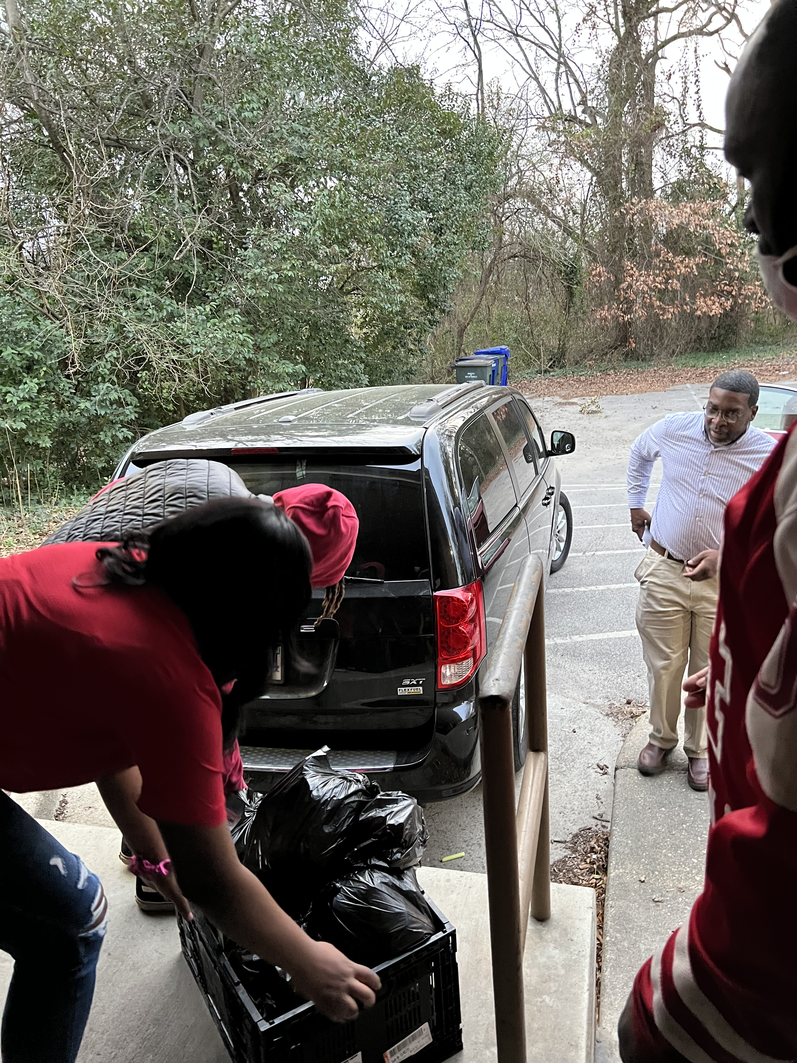

Slide 22
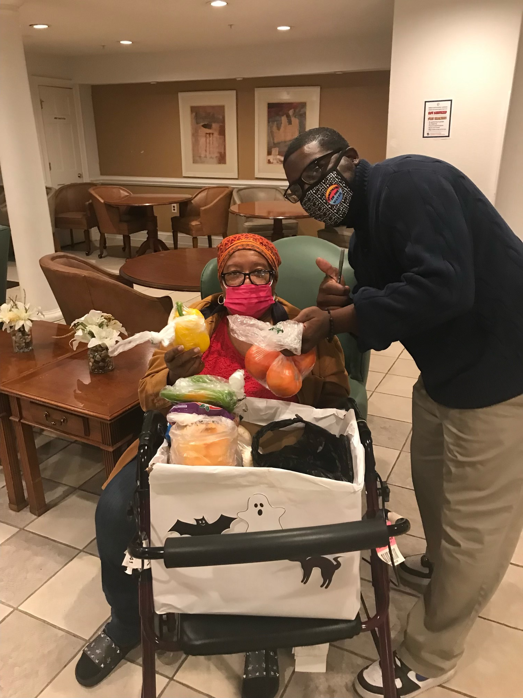
“I’ve lost 50 lbs. since being in the FPP program. My doctor told me to keep doing what I’m doing. ”
~ Josephine J., 67yo with Diabetes and HBP, began the program in November 2021.

Slide 23
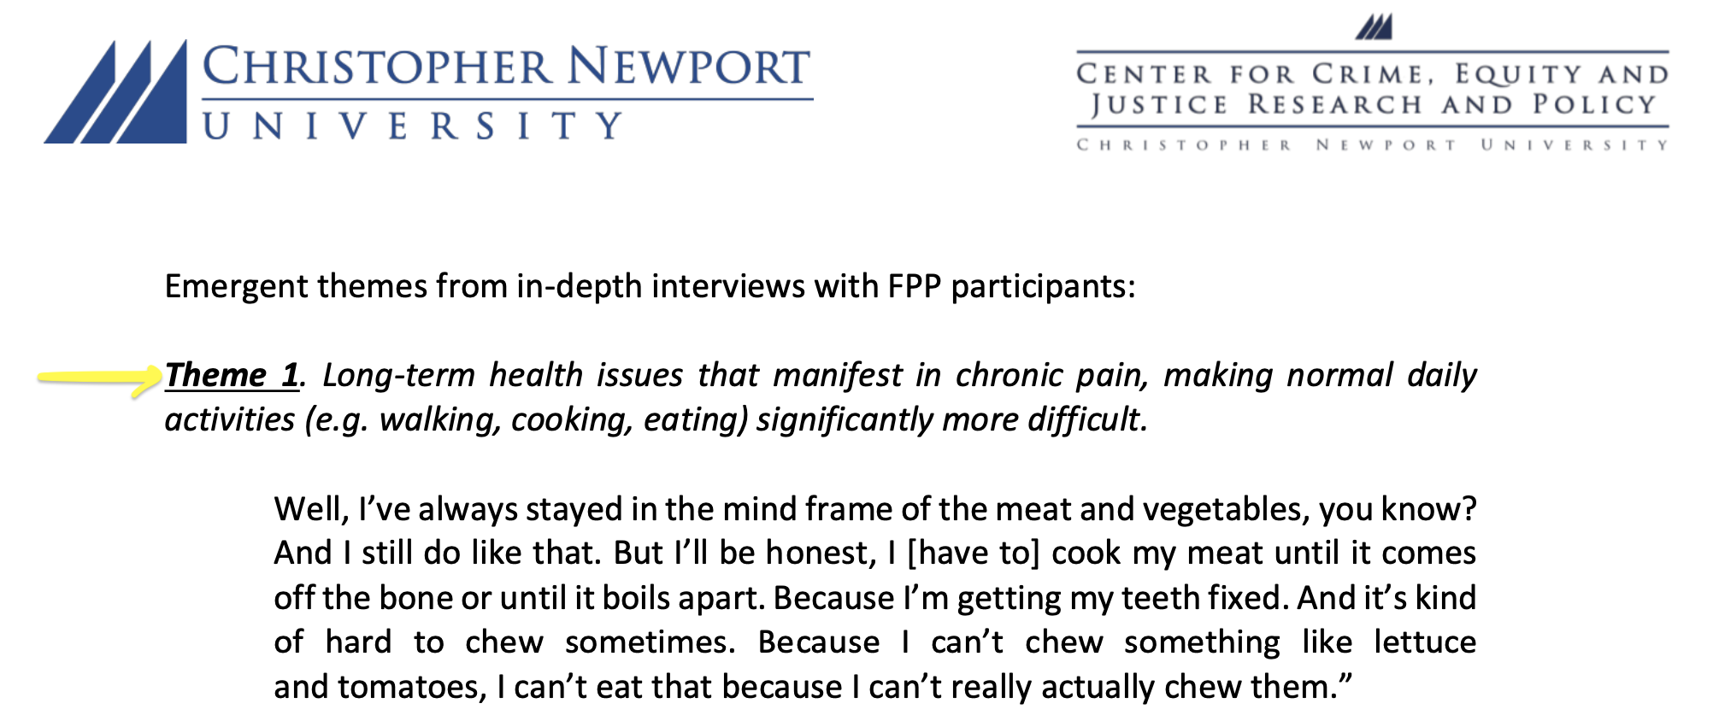
Qualitative Data – Emerging Themes

Slide 24
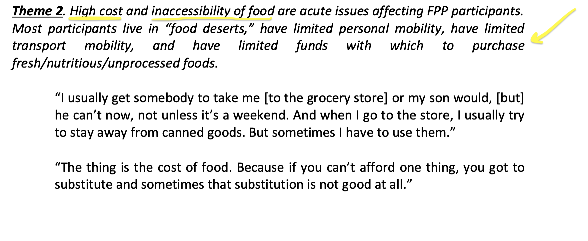
Qualitative Data – Emerging Themes

Slide 25
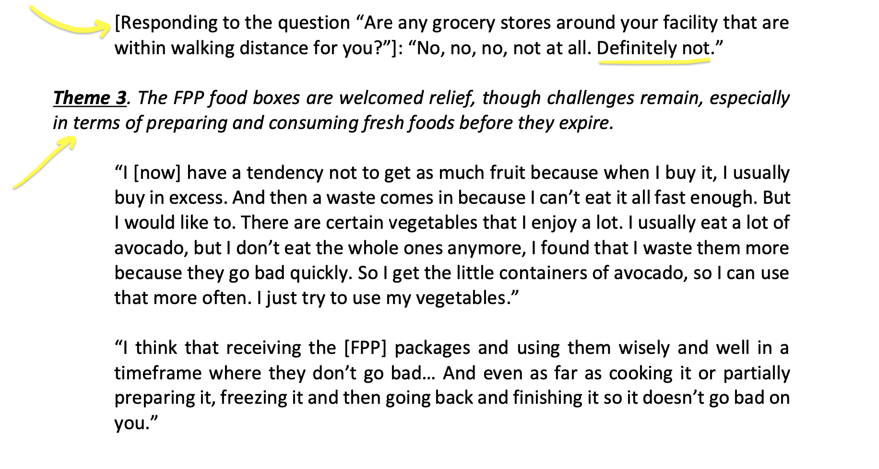
Qualitative Data – Emerging Themes

Slide 26
Collaboration… Leveraging and Expanding Resources and Reach
"If you want to go fast, go alone; but if you want to go far, go together.”
~ African Proverb

Slide 27




Collaboration… Leveraging and Expanding Resources and Reach
Investing in Healthy Futures Together

Slide 28
Q&A
Karen Bailey, Youth Earn & Learn
  Email: youthearnandlearn1@gmail.com
  Website: www.youthearnandlearnonline.org
Leahmarie Gottlieb, St. Paul’s Community Development Corporation
  Email: stpaulcdcva@gmail.com
  Website: www.spcdc-va.org

