Slide 1
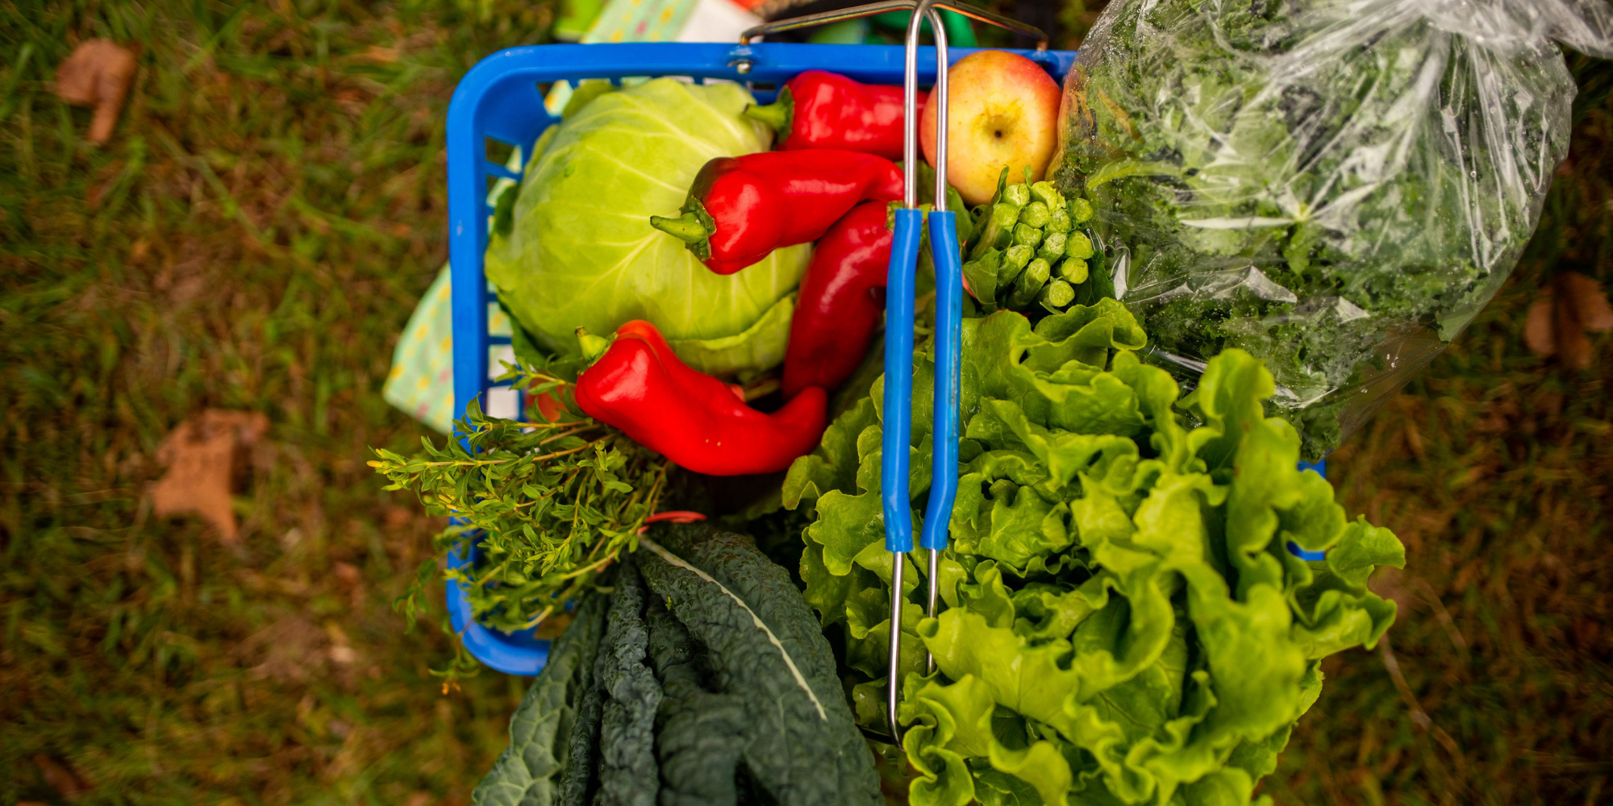
Our vision is a healthier community where everyone has equitable access to nourishing food and meaningful opportunities to grow, choose, cook, and enjoy fresh produce.
Notes:
here to talk about food access - with your research and hearing from others, you already know that simple approach would be to identify that there are people who don’t have financial access to healthy food (or enough food in general) and simply try to fill that gap - but we know that the number of people “facing hunger” increases every year, so that approach is limited in effectiveness
the issue we’ll explore today is that it’s more complex than certain people or communities lacking access - it’s that there are disparities in access - it’s not that there isn’t enough, it’s that our system is so broken that people are denied the right to the components for a healthy life while others have so much they don’t think about the complexity of the system
we can’t disassociate the historic and systemic causes of these disparities in access - and we’ll get into those
this all risks making topic feel more academic or hypothetical or distant - I believe that food is personal, social, and relational so we’ll start by grounding it there
I want to start by having us think about our own relationship with food, our preferences and habits, how those were developed, and how we make the choices that ultimately determine what we eat
what did you you have for dinner last night? let’s unpack - from where (transportation or physical access), how (what tools at home, what knowledge do you have, time), why (cost, health, comfort - culturally familiar/appropriate) *eating out is also a choice, may be limited b/c of lack of kitchen/storage/tools/equipment
average grocery store stocks 40K different items - what are your 3 top factors when at store
point is we’re constantly making food choices, weighing our own circumstances - some in our control, some not - all of this determines your “food access” (not a continuum, there are so many factors)
when barriers exist (geographic access, reliable or convenient transportation, money, familiarity, tools, knowledge), it interferes with the number of options we have and influences what we eat, how we prepare our food, and how/whether we enjoy it

Slide 2
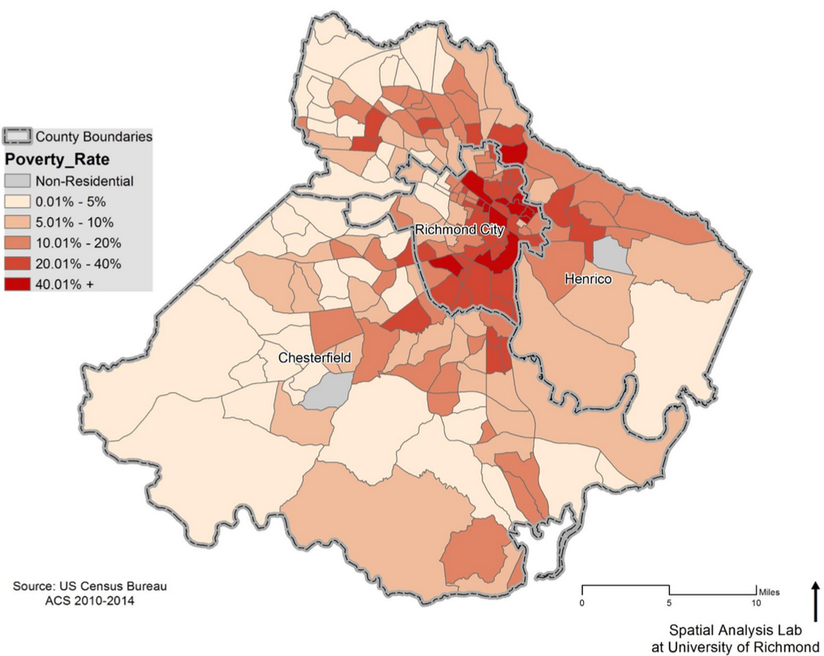
Poverty in
Central Virginia
Notes:
probably seen this or something similar - map of Richmond and two surrounding counties - you can see the darker shades of orange and red indicating higher rates of poverty
darker red (greater than 40% poverty) concentrated in East End and Southside - statewide it’s 10%, 1 in 4 city residents are below poverty line (for 1, less than $13K, HH of 4 $25,500)
does it surprise you to know that these are the same neighborhoods that we don’t see many grocery stores, and where we see highest rates of diet-related chronic disease (diabetes, heart disease)
holding two ideas simultaneously:
more than just access: (not just literal access to food) but higher consumption of healthy food leads to increased health outcomes - we need a broader understanding of access to include more than just physical and financial factors
more than just individual action: a person’s zipcode is a better indicator of health than their individual health behaviors (economic stability, physical environment, education, and food access - SDoH), our priorities need to be based in understanding what inequities exist

Slide 3
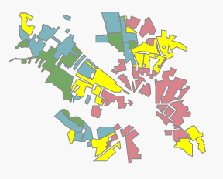
Redlining, Extreme Poverty, and Food Access
Notes:
who has heard the term “food apartheid”? “food desert”?
food apartheid is a term coined by Karen Washington, an urban farmer in NYC. We like this term as an alternative to food desert because it acknowledges that there is nothing natural or accidental about communities with insufficient access to healthy food--they are the result of the deliberate oppression and disenfranchisement of people of color and people experiencing poverty.
left: UR “Mapping Inequality” project shows the practice of redlining - red shows neighborhoods marked “hazardous” in red ink on maps drawn by the federal Home Owners’ Loan Corp. - practiced officially from 1935 to 1939, banned in 1968, redlining was used to prevent financial lending and home ownership to African Americans and other people of color
right Food Policy Task Force (several years old but trends/patterns remain) - vast majority of redlined neighborhoods are today much more likely than other areas to comprise lower-income, minority residents. - and because home ownership is the #1 method of accumulating generational wealth, there is an almost direct correspondence to “food deserts” (purple) and areas of “high poverty” (red)
poverty impacts health through poor housing conditions, disparities in educational and employment opportunities, inadequate transportation infrastructure, access to healthcare and food, and generational stress of economic instability

Slide 4
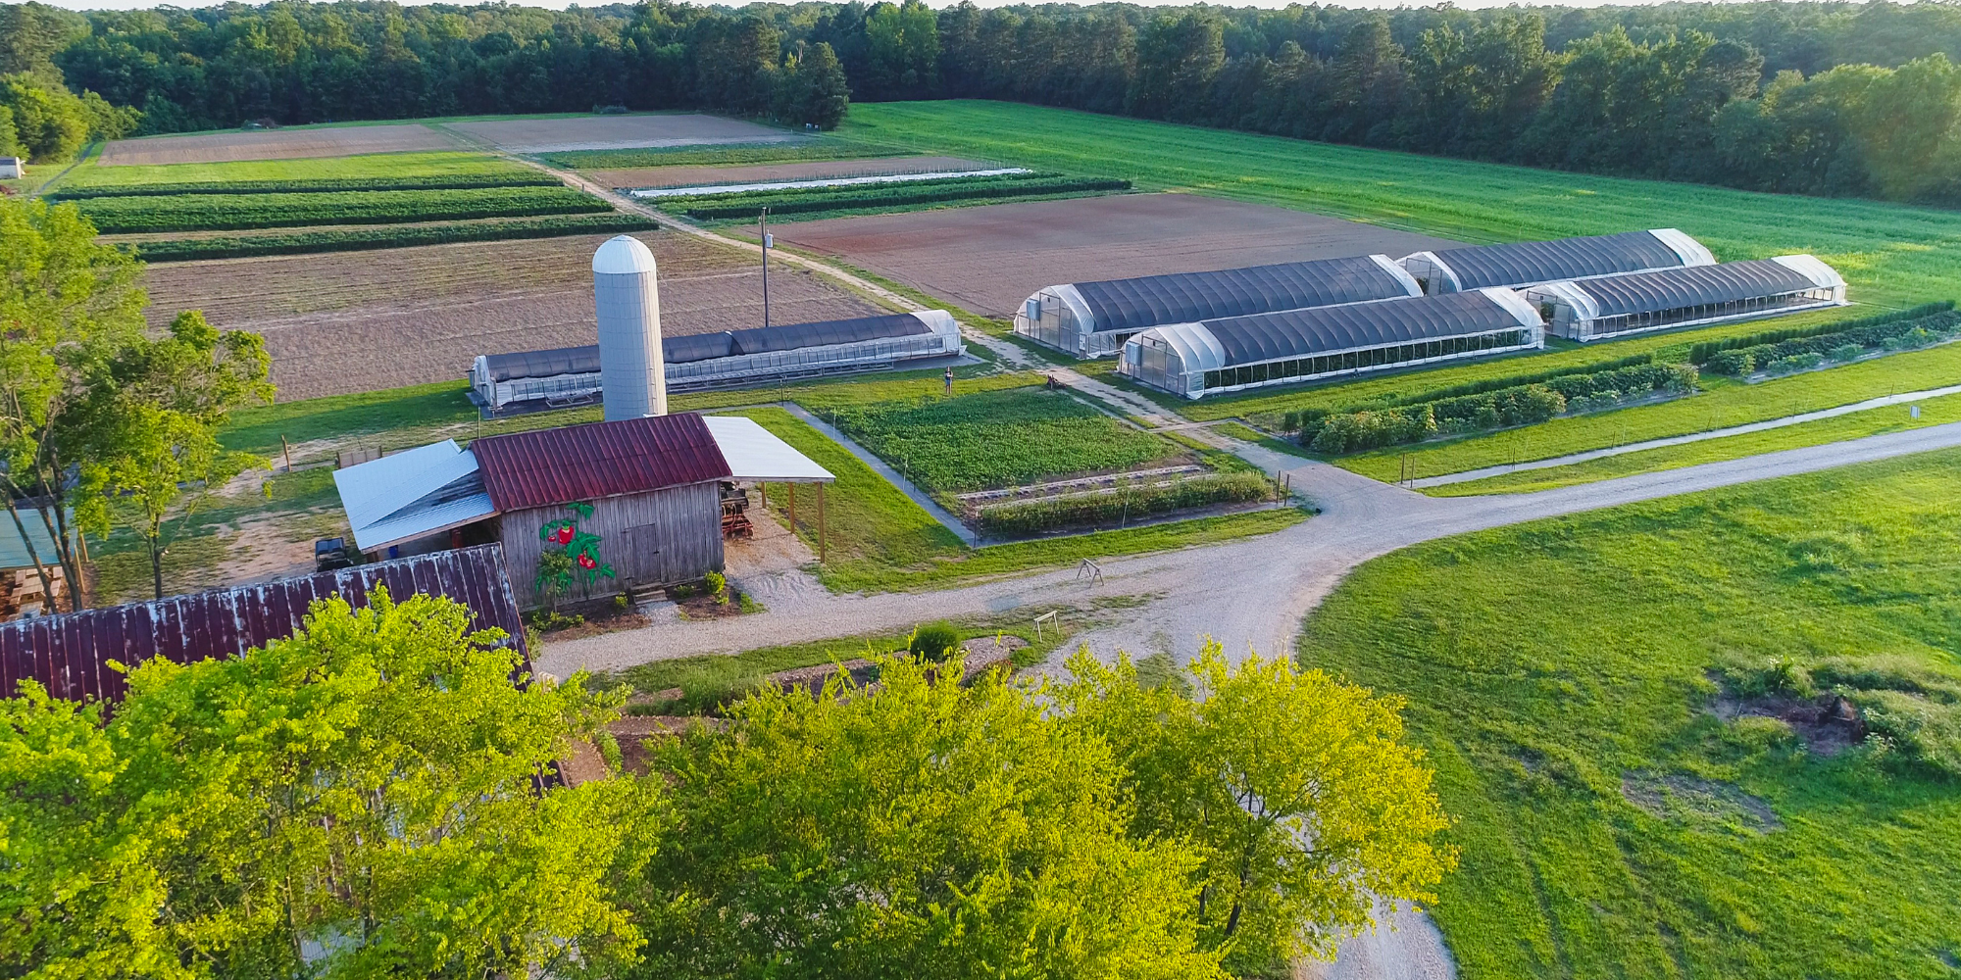
Notes:
we believe everyone should have equity in opportunities to choose healthy foods - our goal is to create level playing field - let’s get into how we approach the solutions and how recognizing the historic and systemic causes of food insecurity can help inform our solutions.
we are nonprofit farm - we’re focused on providing physical and financial access to healthy food and the educational supports to help build skills, confidence, and connection to local food system
grow about 200K lbs. on 8 acres across 2 sites

Slide 5
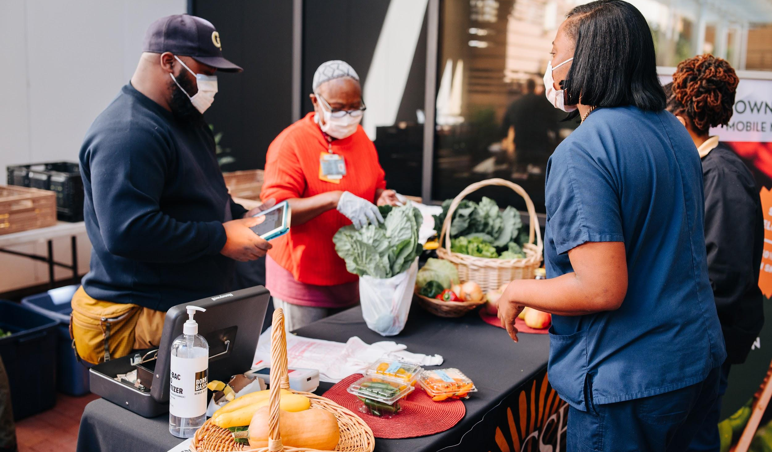
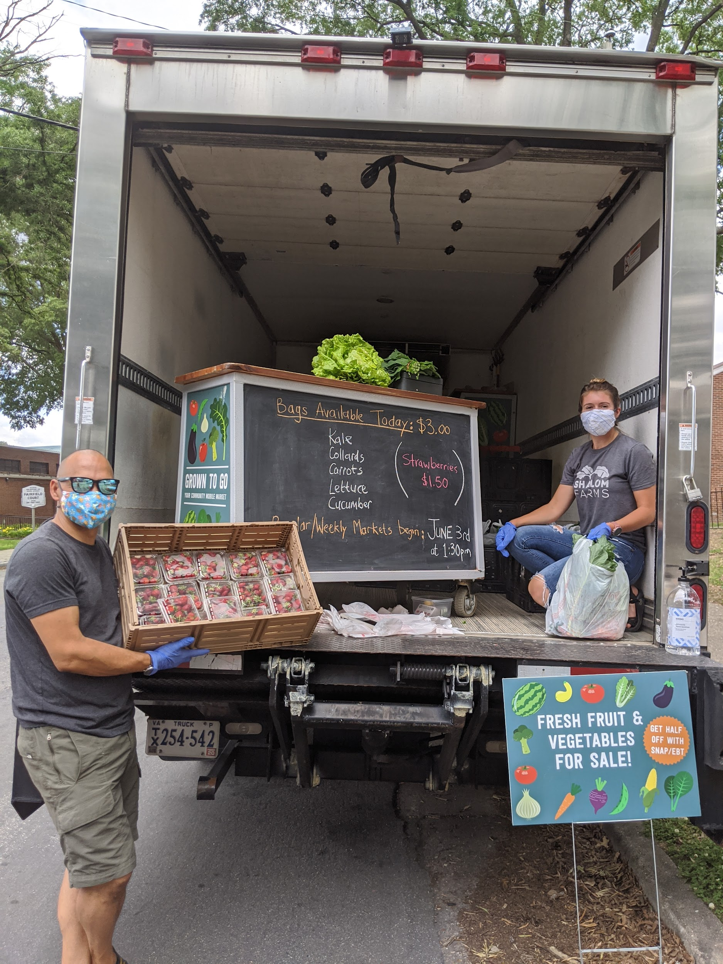
Grown to Go Mobile Market
Location and income should not determine access to healthy food. The Mobile Market visits neighborhoods across the city, connecting communities to fresh, local, and sustainably grown produce.
Notes:
MM - most public-facing program: started in 2017
16 sites, throughout growing season (senior apartments, public housing communities)
all shoppers find affordable prices, SNAP shoppers receive an additional 50% off, and we partner with RCHD, dietetic students, and other community organizations to provide education, fun activities, health checks, and other resources

Slide 6
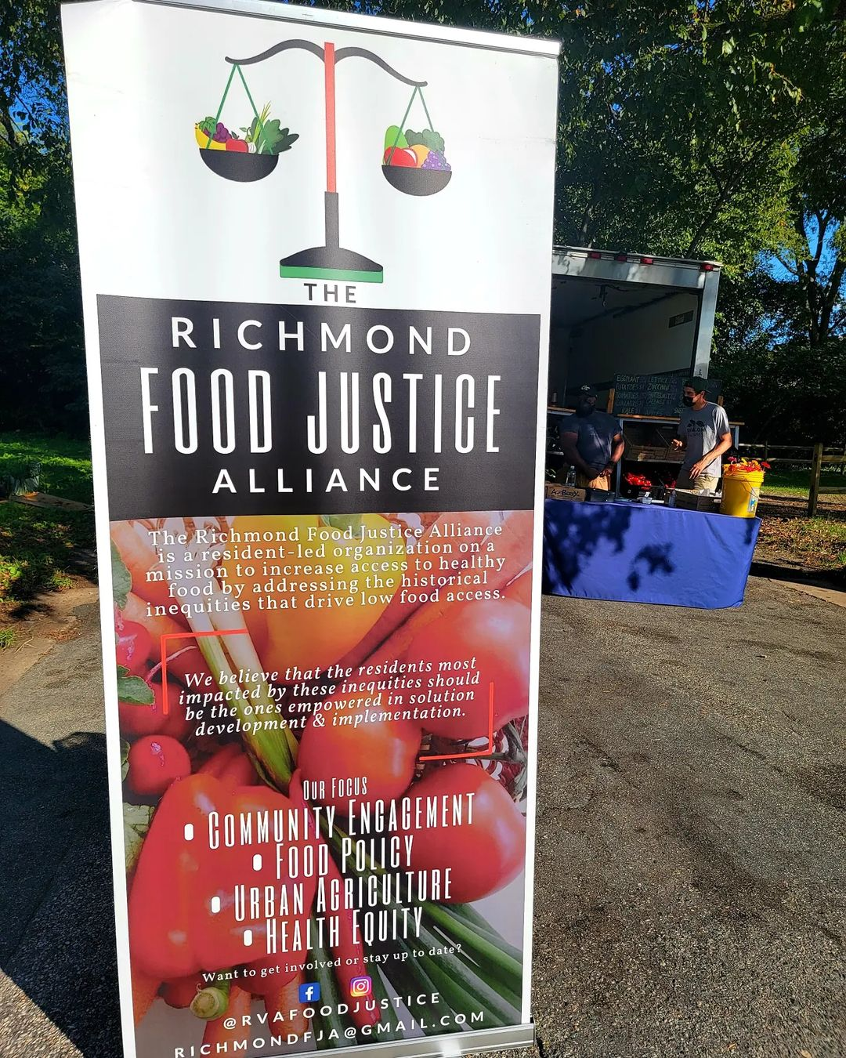
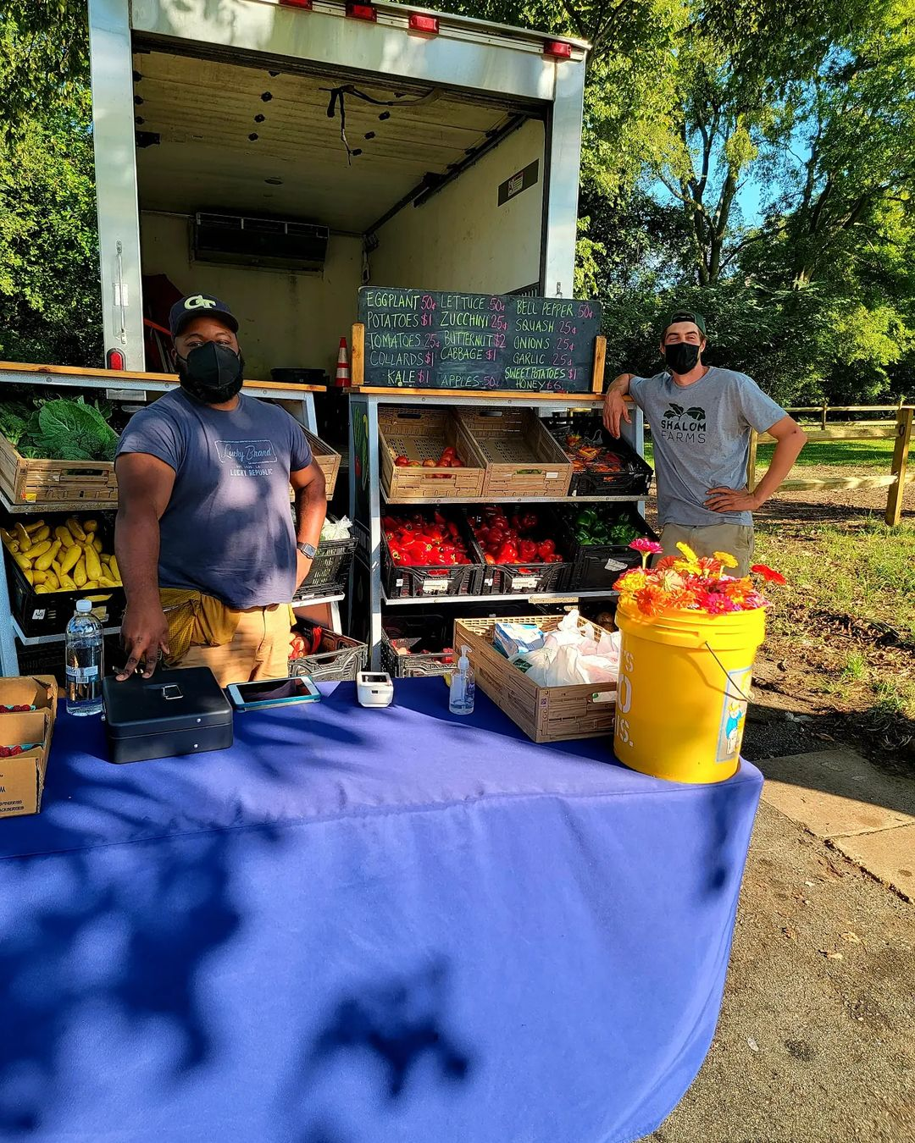

Slide 7
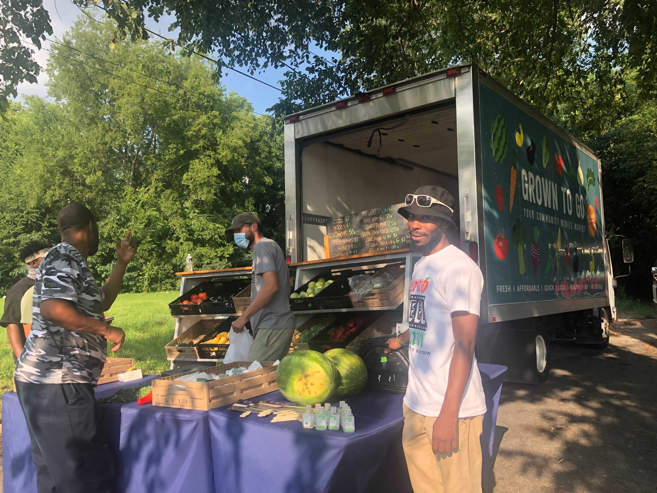

Slide 8
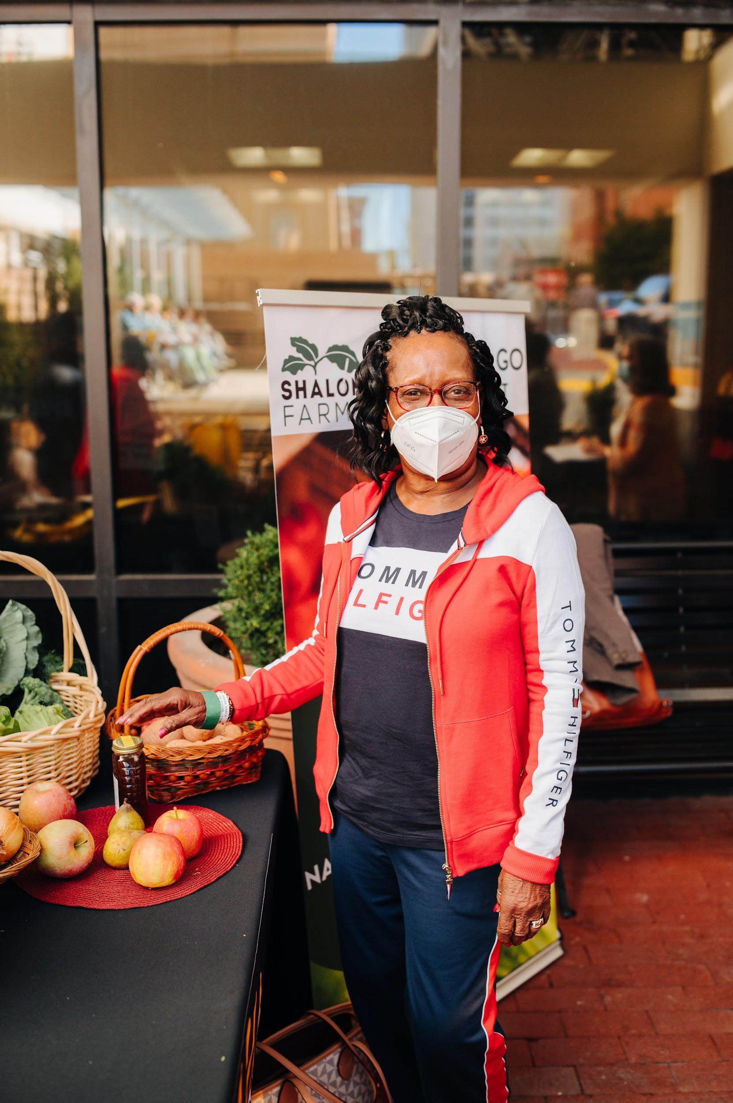
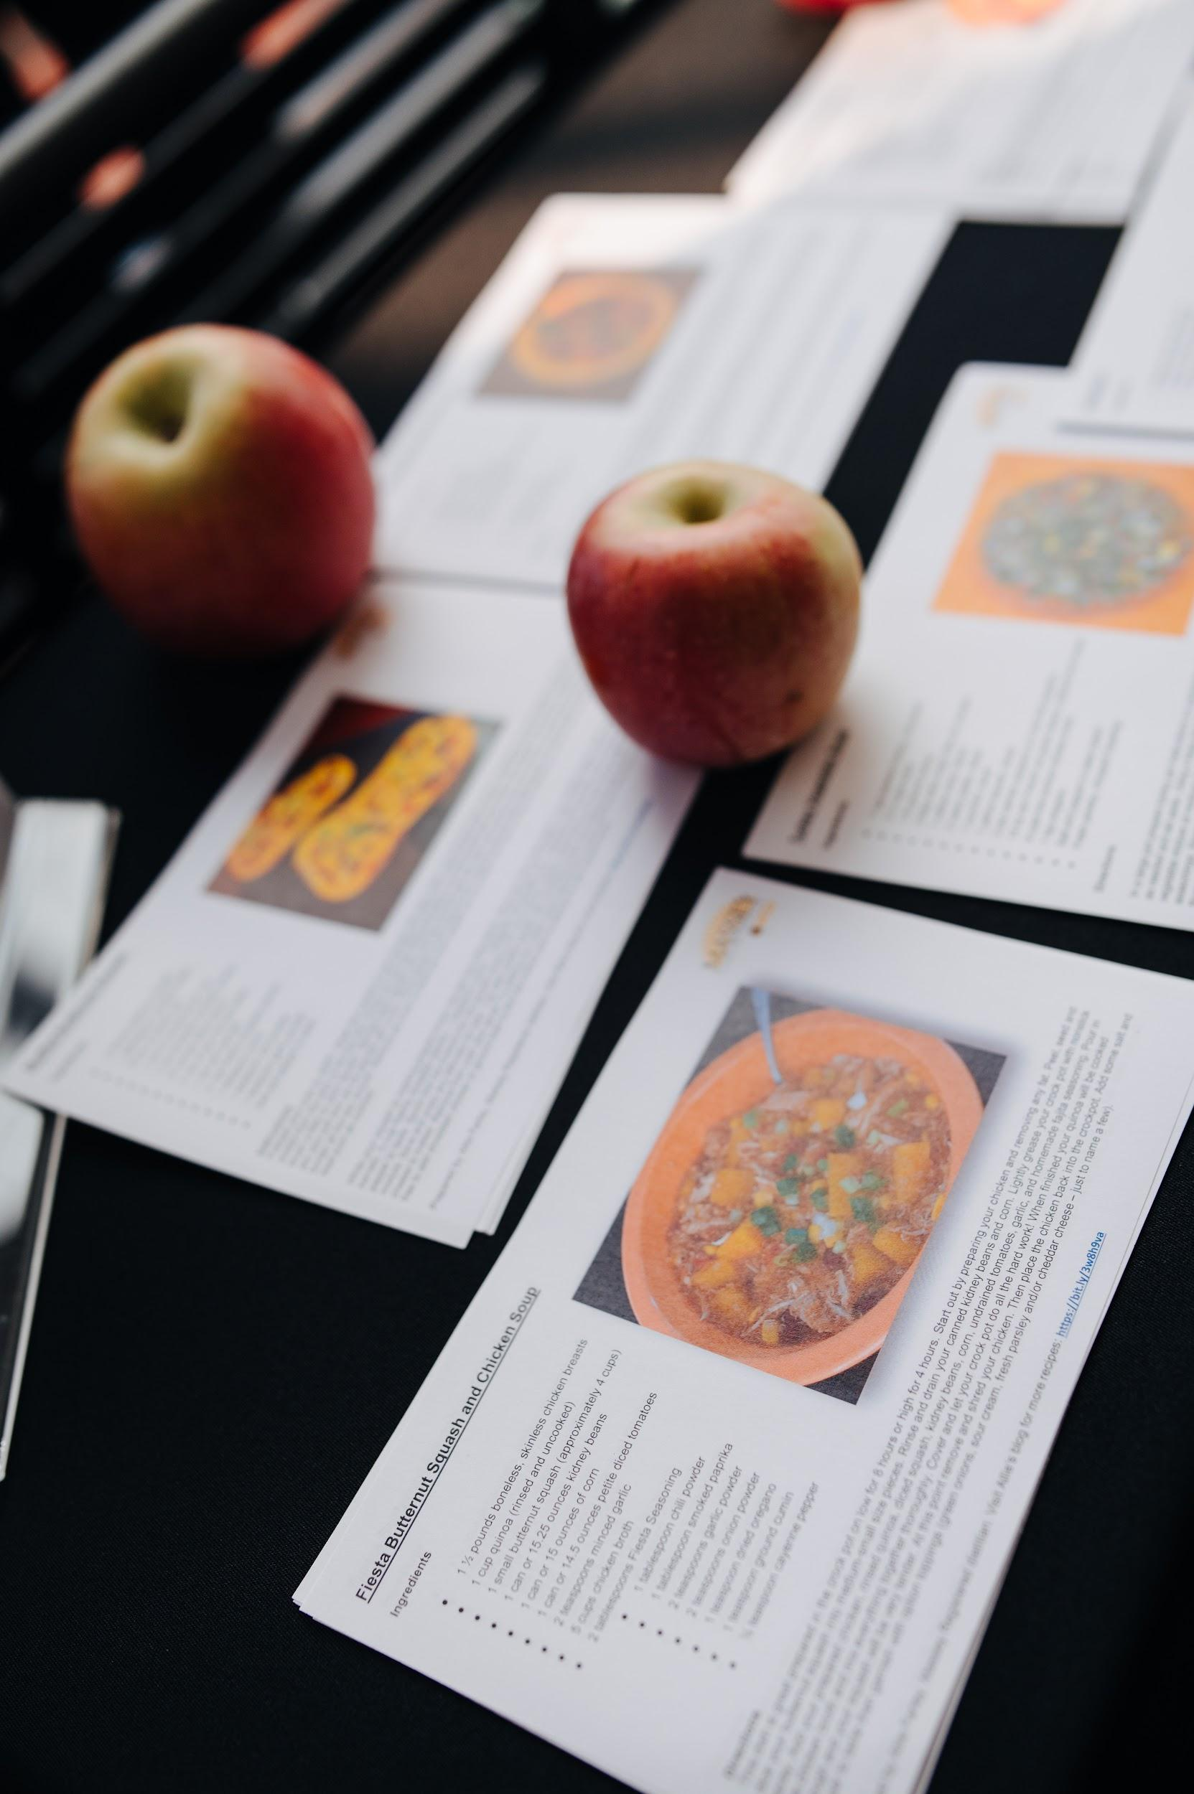

Slide 9
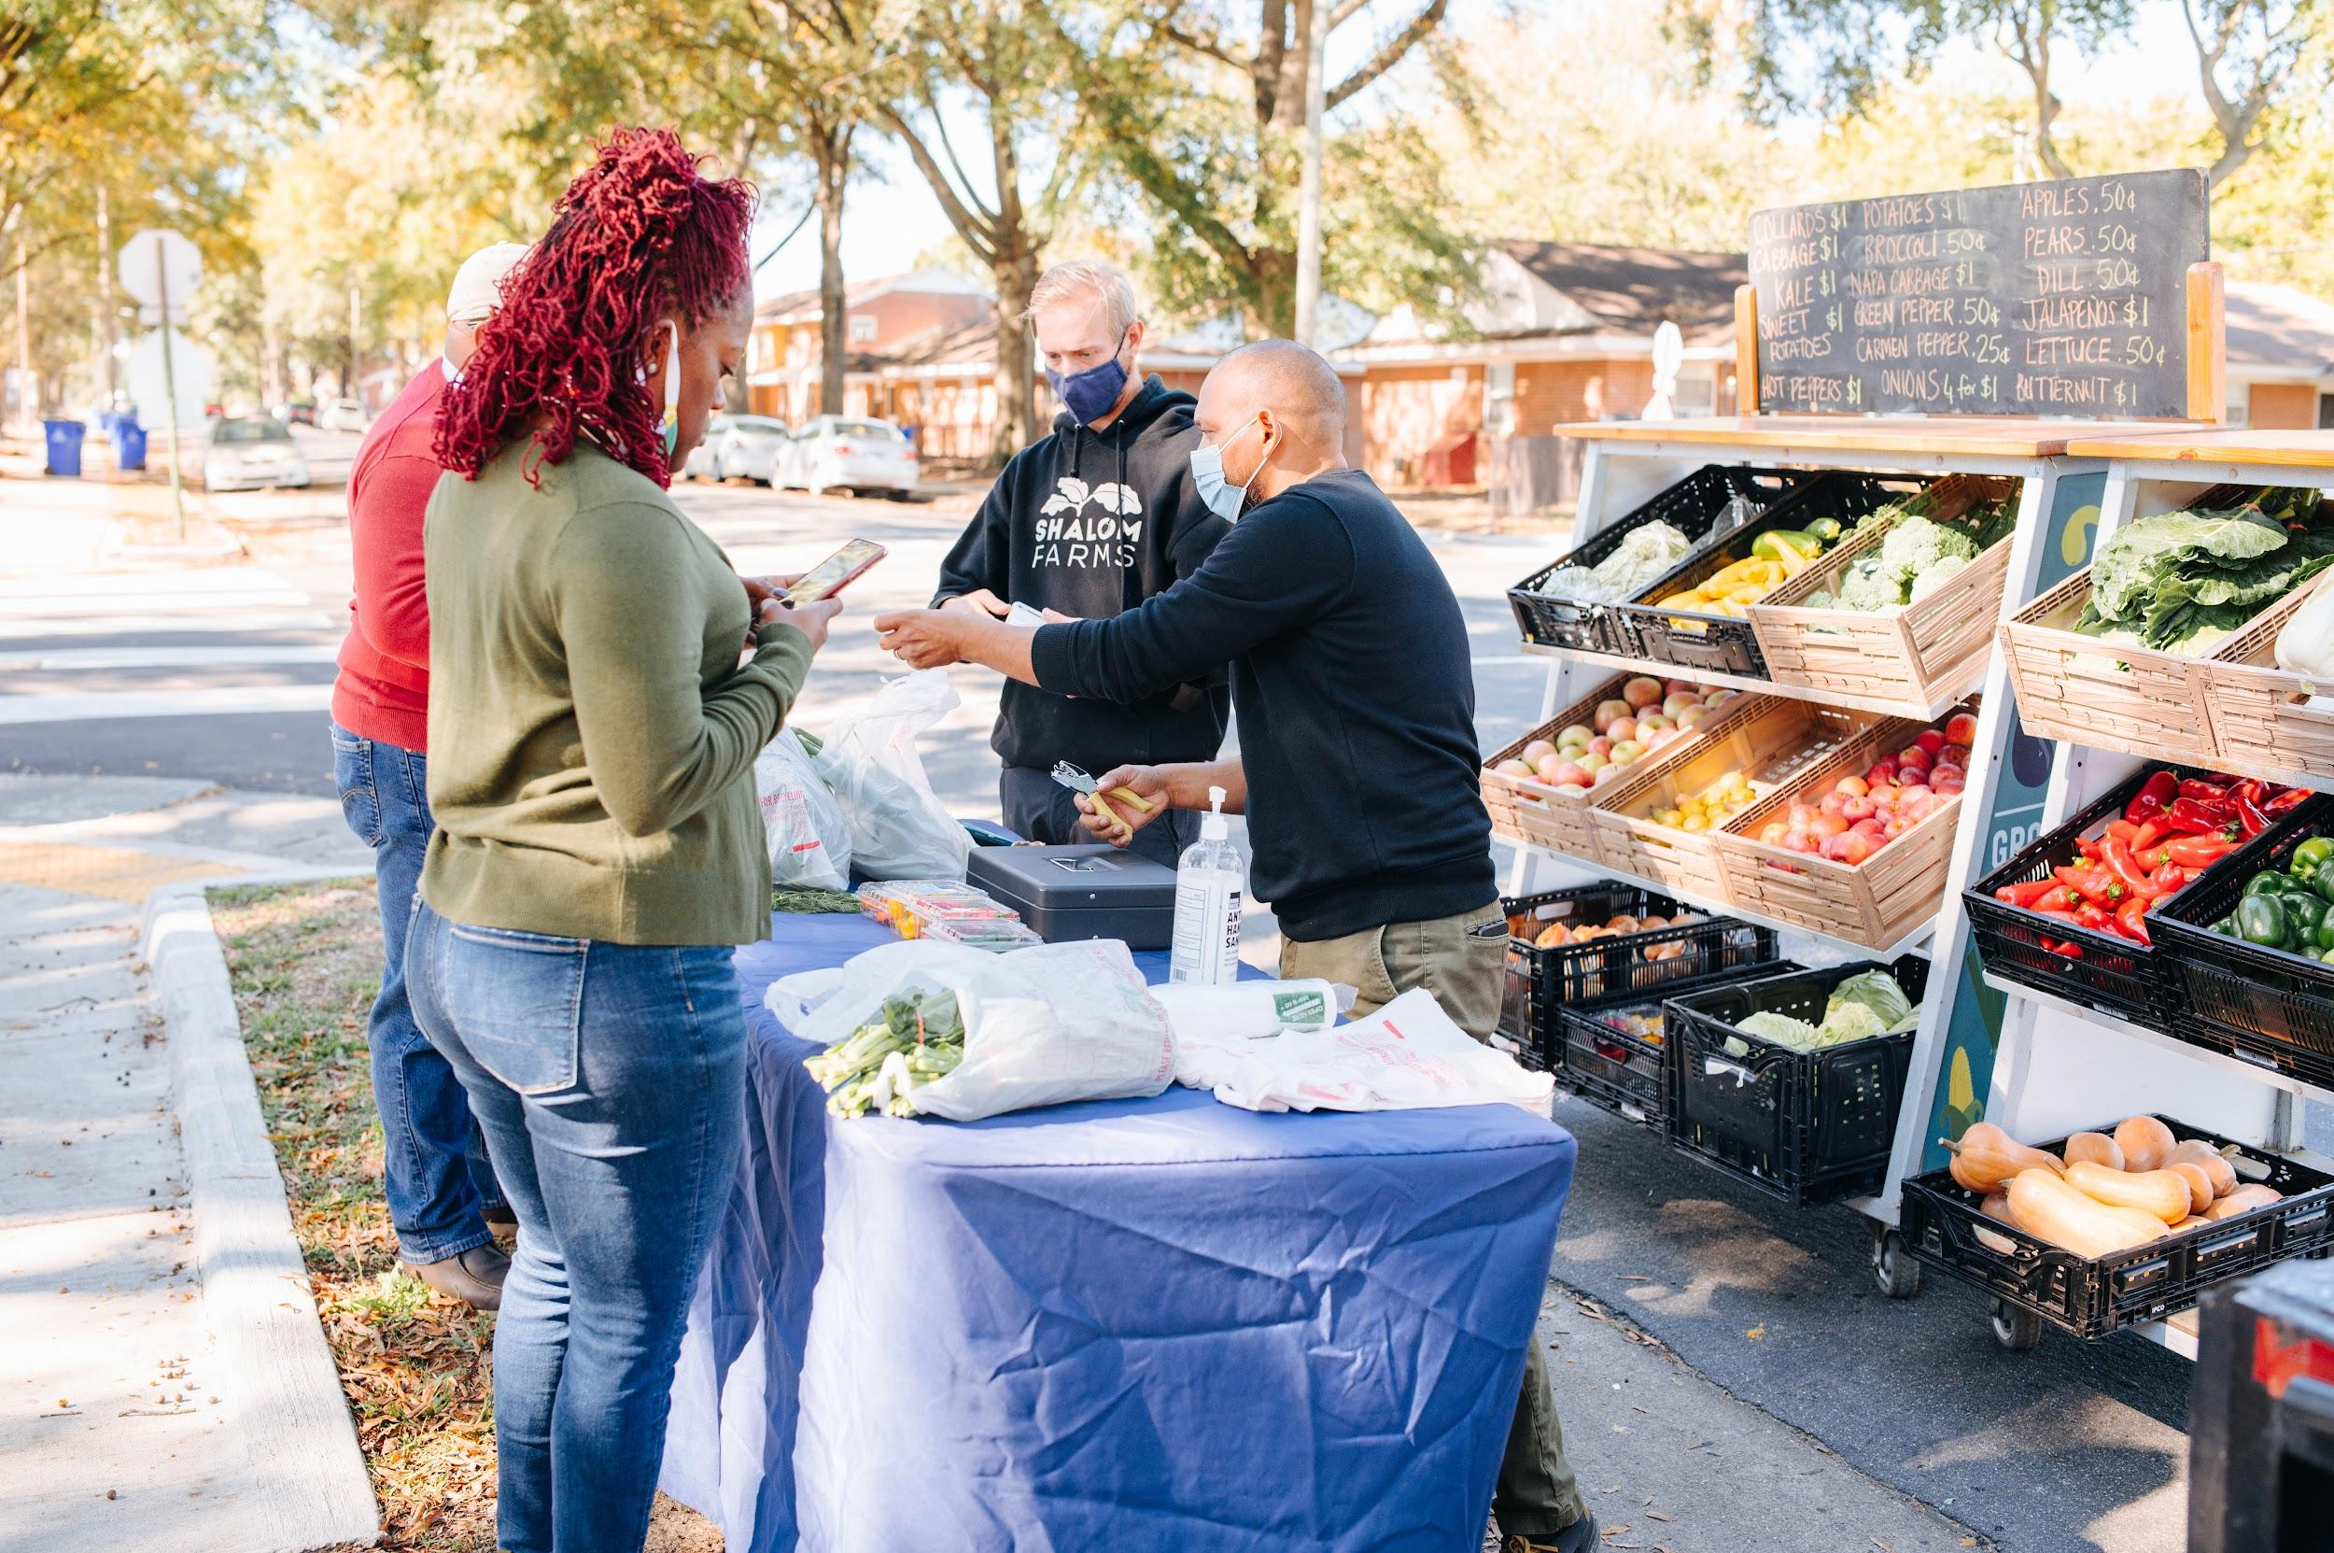

Slide 10
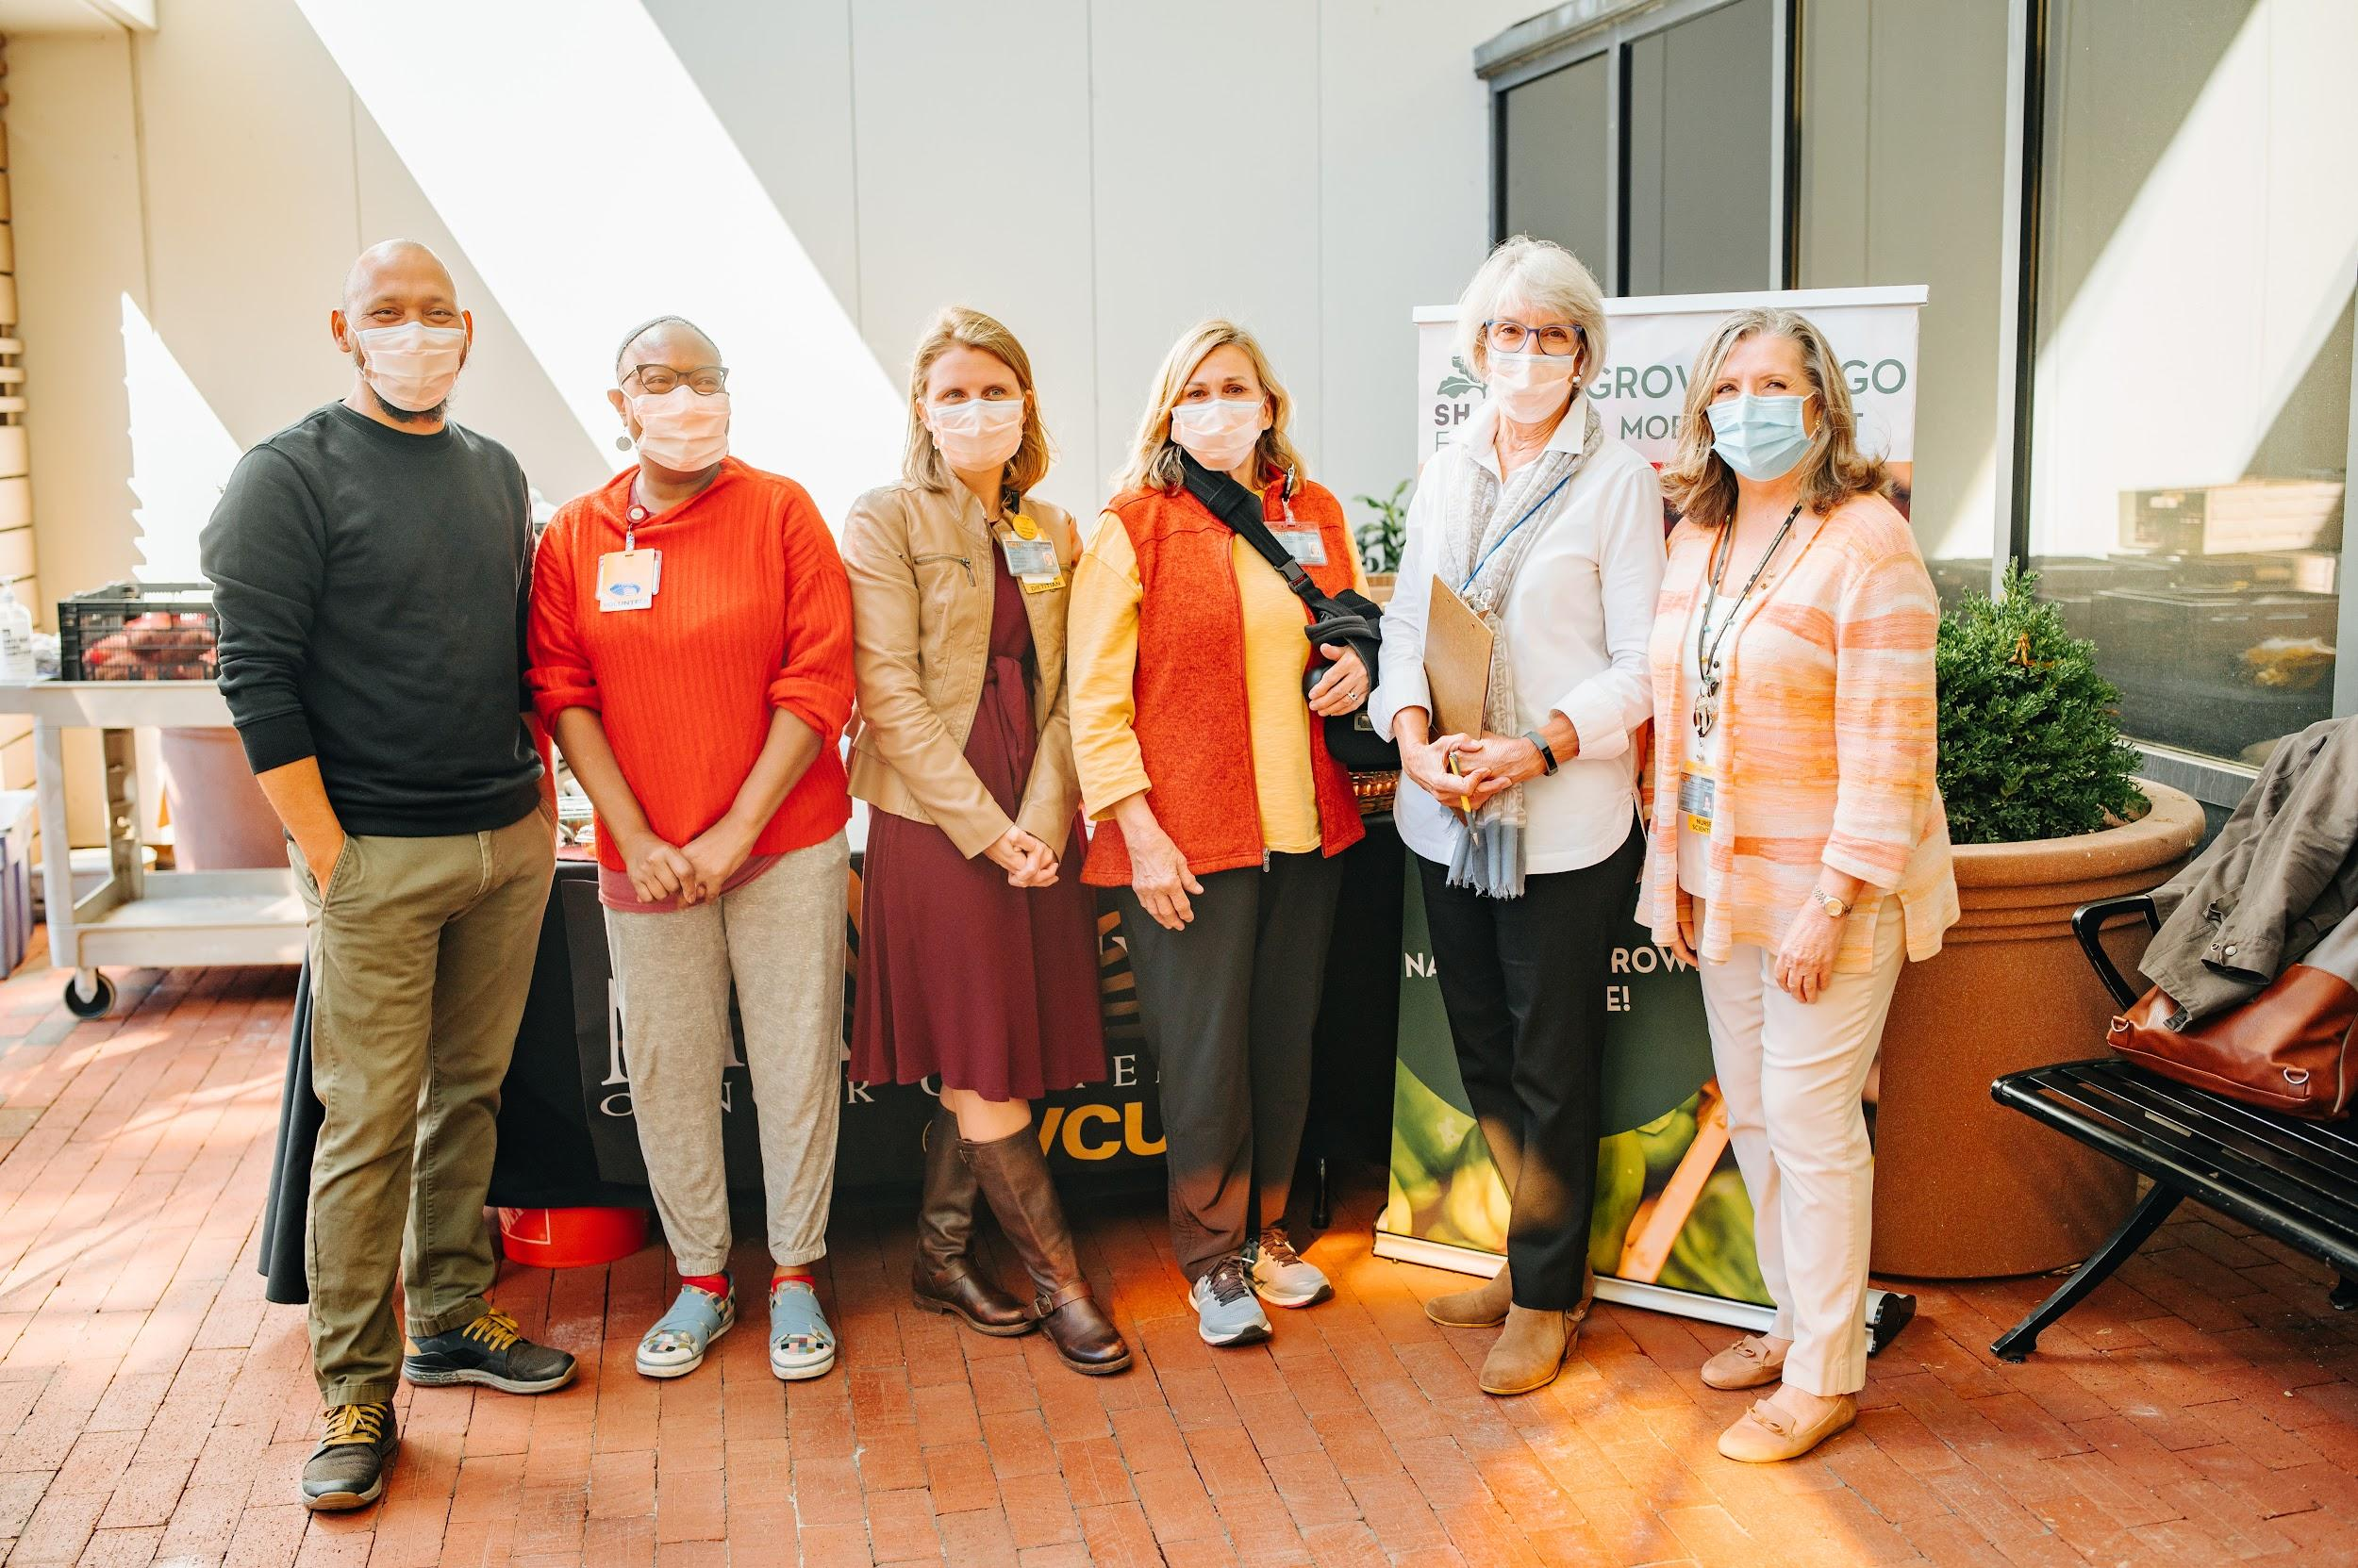

Slide 11
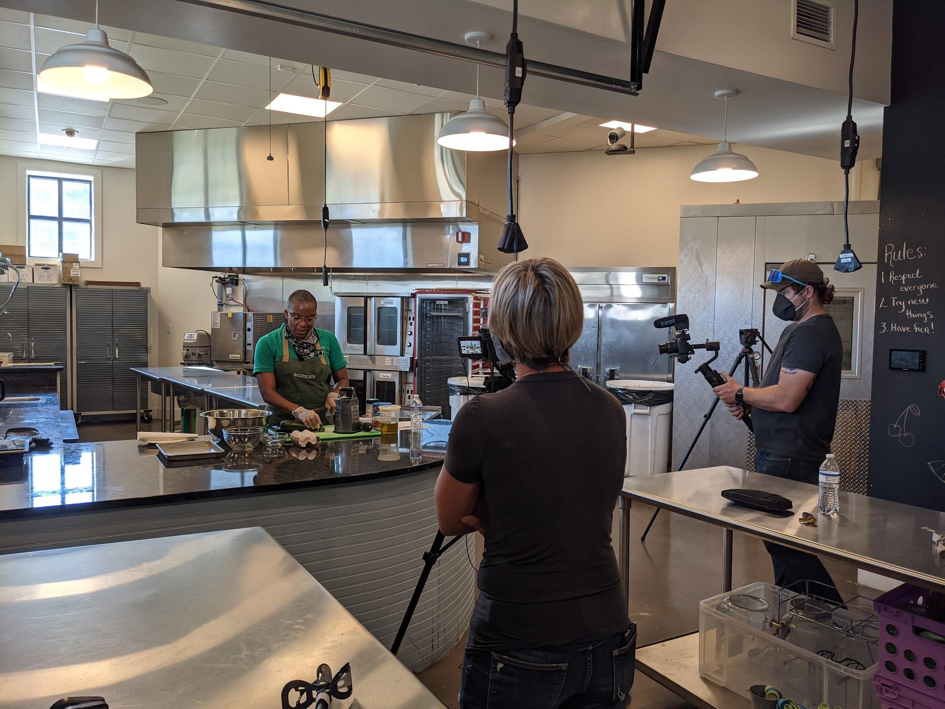
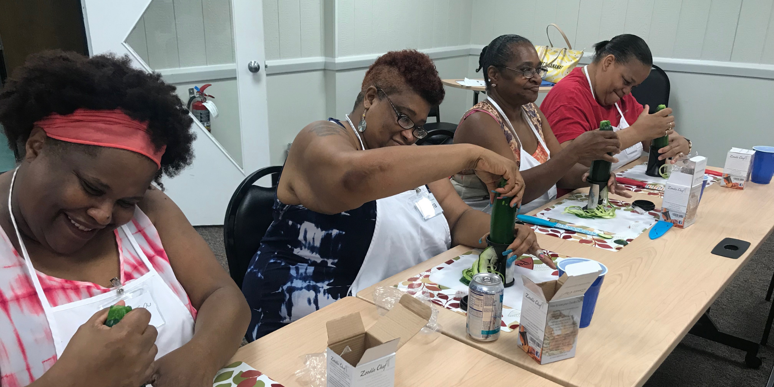
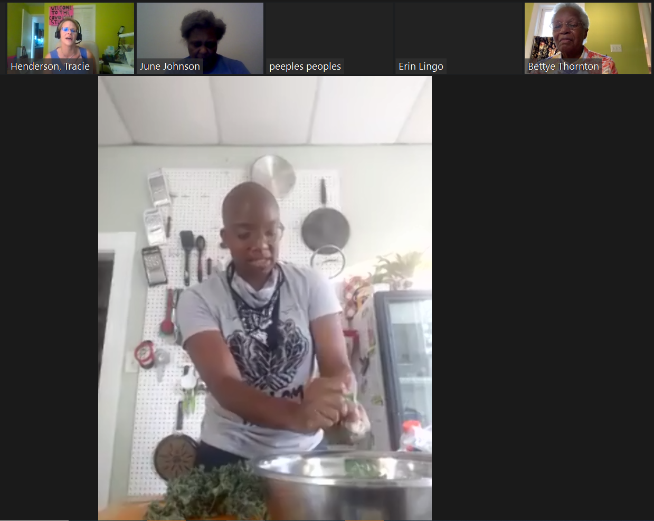
Prescription Produce Plan
Our clinical produce program provides weekly produce and cooking classes to participants enrolled in chronic disease prevention and management programs.
Notes:
thinking back to how we recognized the complexity of food access and health - since 2013, we work with clinical and community partners to create programs for participants that are often already dealing with a diet-related chronic illness - for 3-6 months, all participants receive a weekly box of produce from the farm, a cooking class, nutrition education, a weekly health screening, and goal-setting support

Slide 12
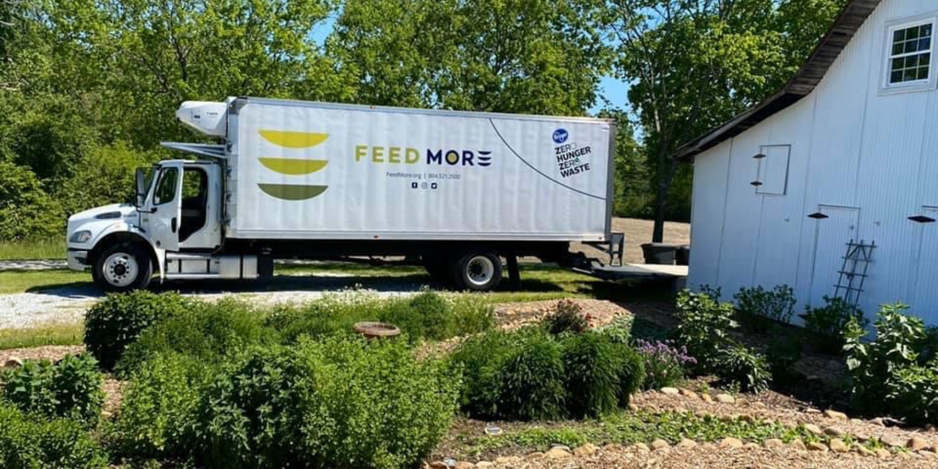
Nutrition Distribution Program
Notes:
While we focus our own distribution efforts on Richmond communities experiencing food apartheid, we also give produce to a number of partner agencies, like Feed More and several other smaller food pantries and meal programs, that can extend our reach and share our produce with individuals and families in crises all over central Virginia

Slide 13
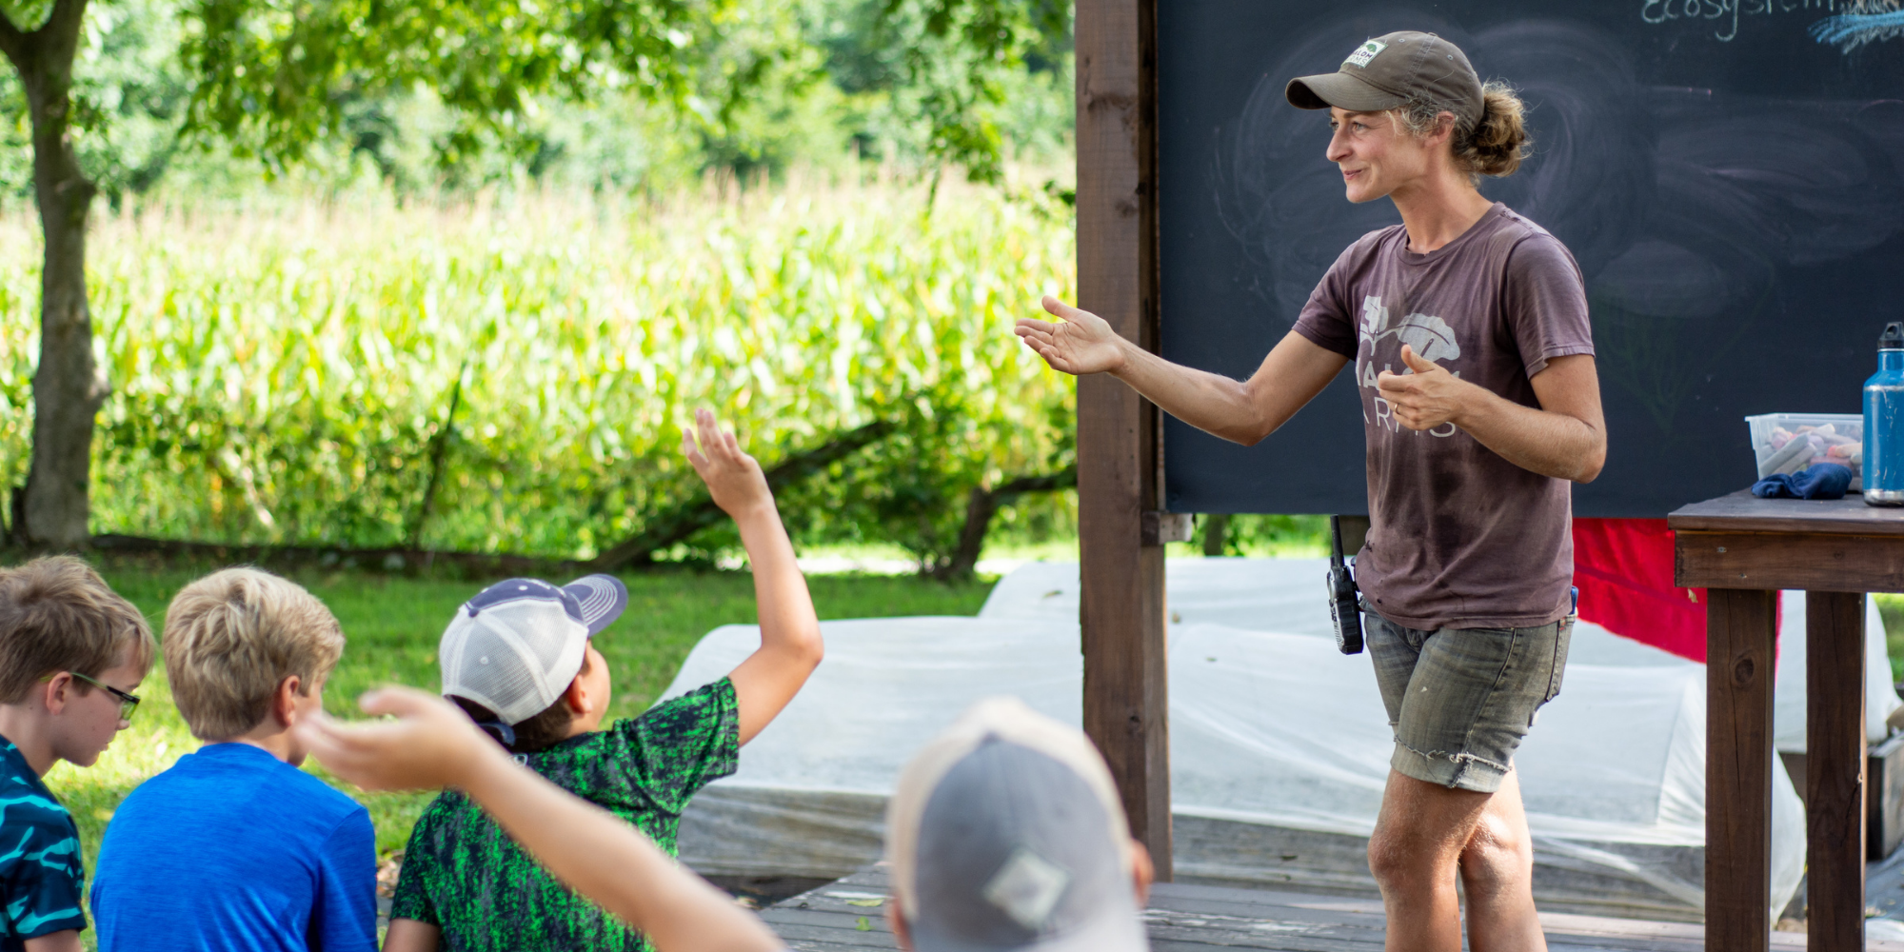
Volunteer and Educational Programming
Notes:
I like to say that we provide multiple touchpoints for connection to the local food system, from production to consumption
on production side - farm sites provide learning opportunities for volunteers and students (7000/yr) and FIR program - focus and an educational touchpoint for learning about agriculture and small-scale market farming
We believe hands on experiences in the soil and in the kitchen are critical to inspiring and supporting healthy eaters and advocates.

Slide 14
Notes:
with a history of injustice, a broken food system that values profit over people, we have a lot to overcome - by acknowledging systemic causes and centralizing justice instead of charity, and trying to align our work with our values of equity, we look forward to that day when we have met our vision of healthier communities and equitable access, and don’t have to exist - until then we work as one part of a network of organizations, activists, and community members to make more produce available in a way that is affordable, dignified, and culturally appropriate.

Slide 16
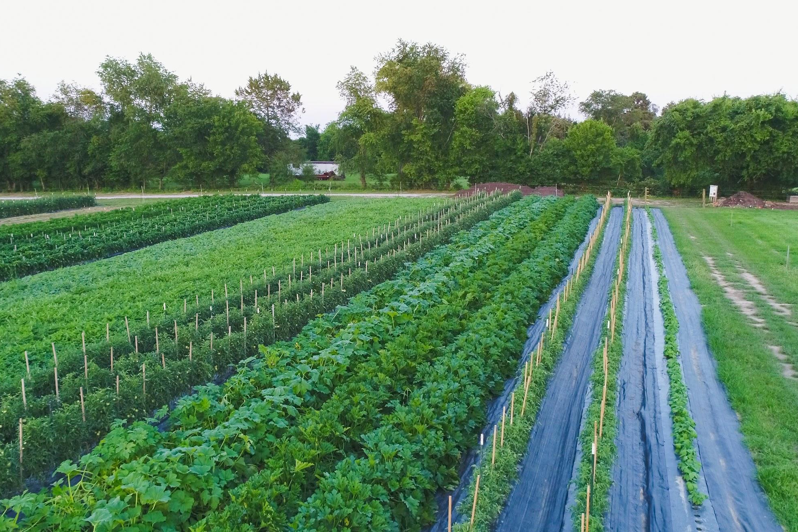

Slide 17
Questions?
Erin Lingo
erin@shalomfarms.org
shalomfarms.org

